Slide 1

Lecture 7 Relational Database Design Theory
(关系数据库设计理论)
Prof. Jihong Guan
Email: jhguan@tongji.edu.cn
Department of Computer Science and Technology
Tongji University

Slide 2
Outline of the Course
Part 0: Overview
Ch1: Introduction
Part 1 Relational Databases
Ch2: Relational model (data model, relational algebra)
Ch3&4: SQL(Structured Query Language)
Ch5: Advanced SQL
☞ Part 2 Database Design
Ch6: Database design based on E-R model
Ch7: Relational database design
Part 3 Application Design & Development
Ch8: Complex data types
Ch9: Application development
Part 4 Big data analytics
Ch10: Big data
Ch11: Data analytics
Part 5 Data Storage & Indexing
Ch12: Physical storage system
Ch13: Data storage structure
Ch14: Indexing
Part 6 Query Processing & Optimization
Ch15: Query processing
Ch16: Query optimization
Part 7 Transaction Management
Ch17: Transactions
Ch18: Concurrency control
Ch19: Recovery system
Part 8 Parallel & Distributed Database
Ch20: Database system architecture
Ch21-23: Parallel & distributed storage, query processing & transaction processing
Part 9
DB Platform:OceanBase, MongoDB, Neo4J

Slide 3
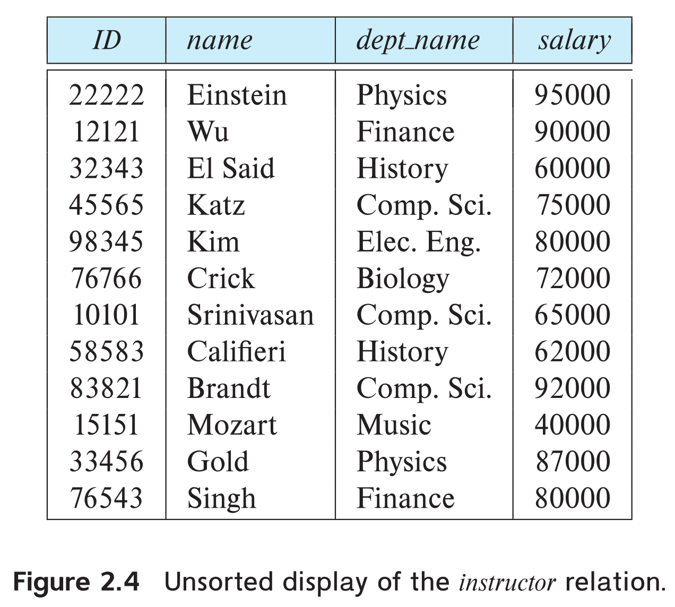
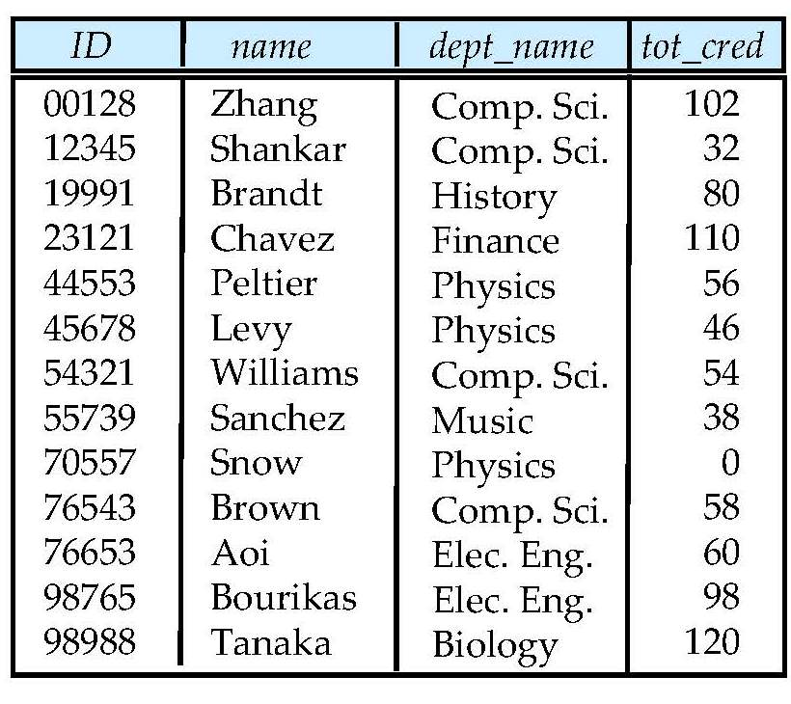
University Database
Instructor table
Student table

Slide 4
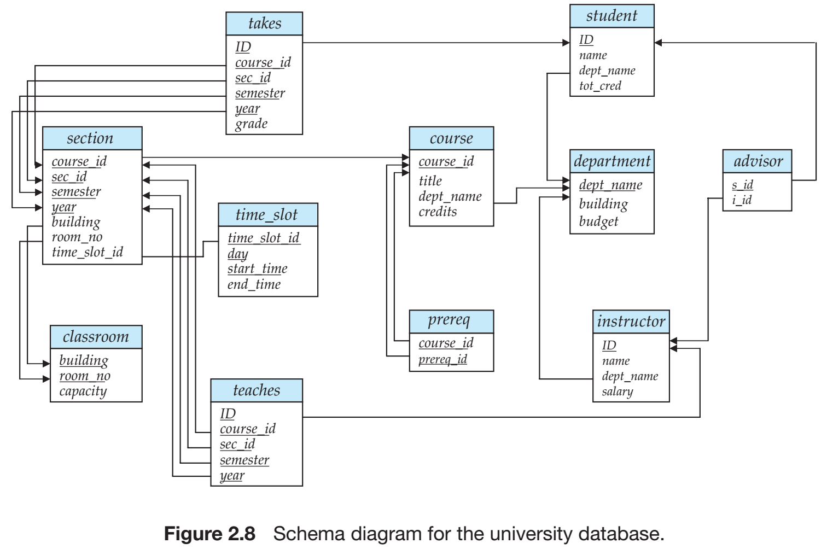
University Database
Relational Model
SQL
Database Design
Storage & Query
Transactions

Slide 5
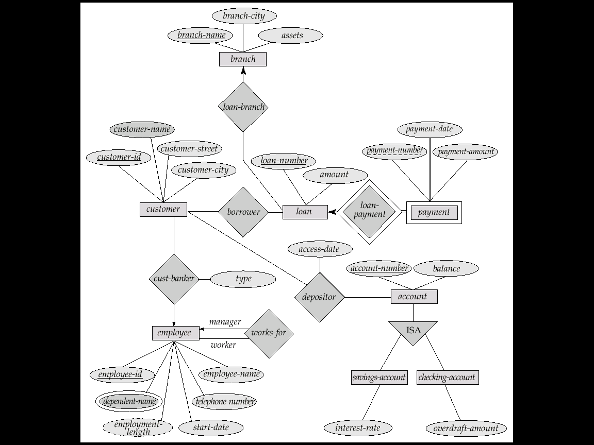
E-R Diagram for a Banking Enterprise
account-branch
Weak entity sets
multi-valued attribute
derived attribute

Slide 6
The Banking Schema
branch = (branch_name, branch_city, assets)
customer = (customer_id, customer_name, customer_street, customer_city)
loan = (loan_number, amount)
account = (account_number, balance)
employee = (employee_id, employee_name, telephone_number, start_date)
dependent_name = (employee_id, dname) (derived from a multivalued attribute)
account_branch = (account_number, branch_name)
loan_branch = (loan_number, branch_name)
cust_banker = (customer_id, employee_id, type)
borrower = (customer_id, loan_number)
depositor = (customer_id, account_number, access_date)
works_for = (worker_employee_id, manager_employee_id)
payment =(loan_number,payment_number,payment_date,payment_amount)
savings_account = (account_number, interest_rate)
checking_account = (account_number, overdraft_amount)

Slide 7
Outline
☞ Features of Good Relational Designs
Functional Dependency/函数依赖
Decomposition using functional dependency
Closure of functional dependency
Closure of attribute sets
Canonical cover
Lossless-join decomposition
Dependency preservation
Normalization & Normal Forms (范式)
Multivalued Dependencies*
Database Design Process

Slide 8
Larger Relation Schema/更大的模式
inst_dept (ID, name, salary, dept_name, building, budget)
Redundant（冗余）: dept_name, building, budget
Inconsistent（不一致）: dept_name, building, budget
Insert failure: cannot insert a tuple without ID, name, salary
Functional dependency is needed
dept_name → budget
Decomposition
inst_dept
instructor(ID, name, salary, dept_name)
department(dept_name, building, budget)

Slide 9
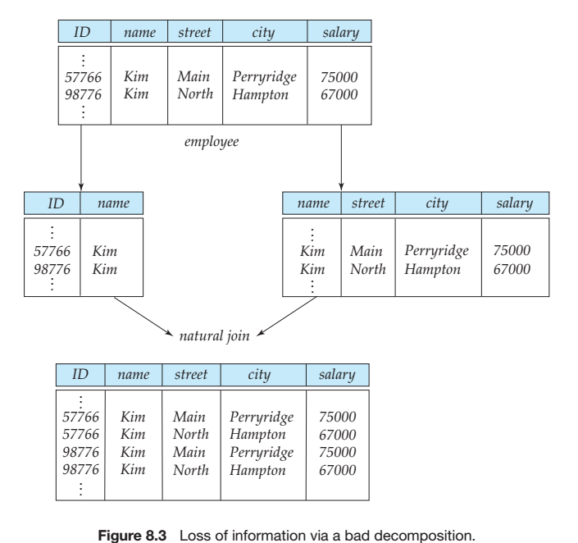
Smaller Relation Schema/更小的模式
More tuples mean lossy decompositions

Slide 10
Good Relation Schema
RDB design is to find a “good” collection of schemas. A bad design may lead to
Repetition of information
Inability to represent certain information
Design goals
Avoid redundant data
Ensure that relationships among attributes are represented
Facilitate the checking of updates for violation of database integrity constraints

Slide 11
Outline
Features of Good Relational Designs
☞ Functional Dependency（函数依赖）
☞ Decomposition using functional dependency
Closure of functional dependency
Closure of attribute sets
Canonical cover
Lossless-join decomposition
Dependency preservation
Normalization & Normal Forms (范式)
Multivalued Dependencies*
Database Design Process

Slide 12
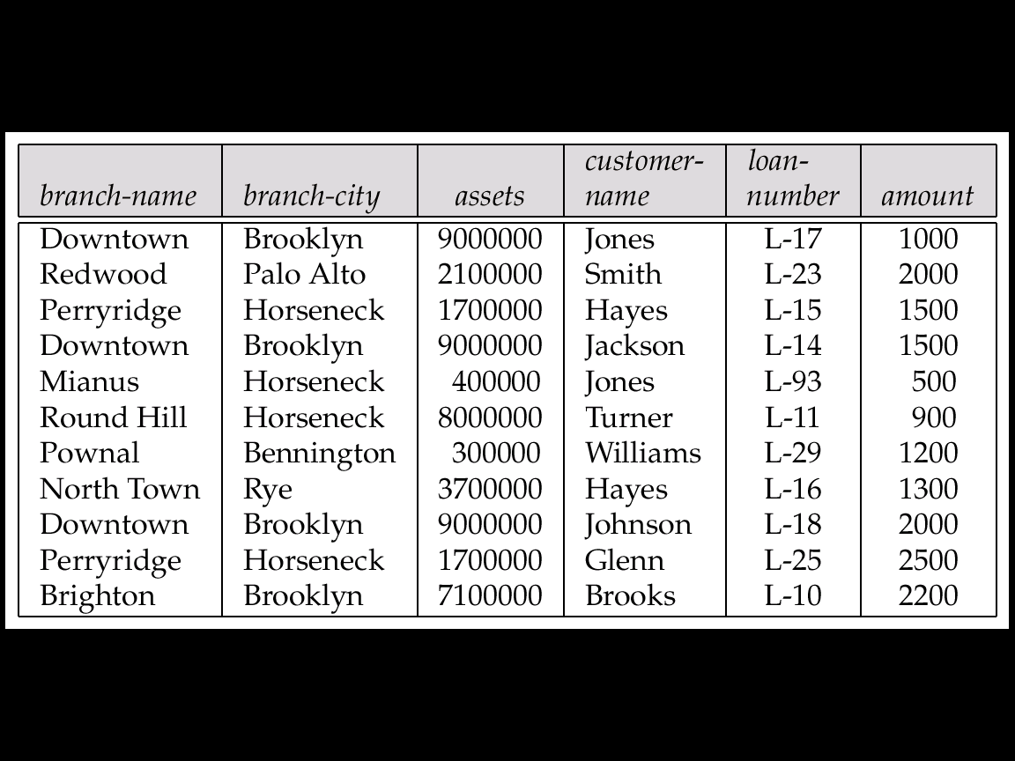
Example
Consider the relation schema: lending_schema = (branch_name, branch_city, assets, customer_name, loan_number, amount)
Redundancy
Data for branch_name, branch_city, and assets are repeated for each loan that a branch makes
Waste space, complicate updating, and introduce possibility of inconsistency of assets value
Null values
Cannot store information about a branch if no loans exist
Can use null values, but they are difficult to handle

Slide 13
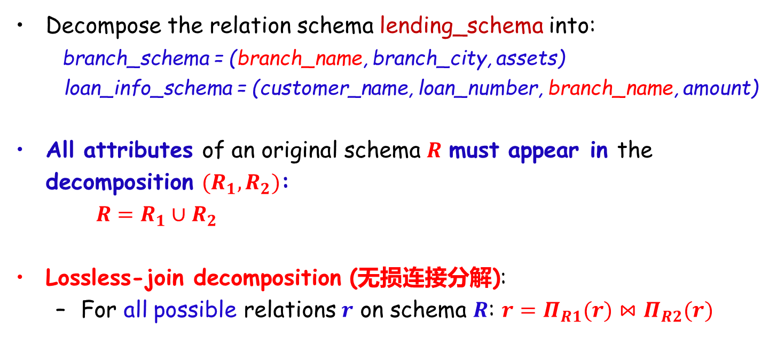
Decomposition
Decompose the relation schema lending_schema into:
branch_schema = (branch_name, branch_city, assets)
loan_info_schema = (customer_name, loan_number, branch_name, amount)
All attributes of an original schema $R$ must appear in the decomposition $(R_{1},R_{2})$:
$R=R_{1}∪R_{2}$
Lossless-join decomposition (无损连接分解):
For all possible relations $r$ on schema $R$: $r=Π_{R1}(r)⋈Π_{R2}(r)$

Slide 14
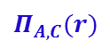


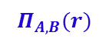
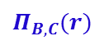
Example of Non Lossless-Join Decomposition
Decomposition of R = (A, B, C)
R₁ = (A,C), R₂ = (B,C)
R₁ = (A,B) R₂ = (B,C)？
lossy
$$r$$
lossless
$$Π_{A,C}(r)$$
$$Π_{B,C}(r)$$
$$Π_{A,B}(r)$$
A | B | C
α | 1 | 1
α | 2 | 1
β | 1 | 1
A | C
α | 1
β | 1
B | C
1 | 1
2 | 1
A | B
αα | 1 2
β | 1
∏_{AC} (r) ∏_{BC} (r)
∏_{AB} (r) ∏_{BC} (r)
A | B | C
α | 1 | 1
α | 2 | 1
β | 1 | 1
β | 2 | 1
$$r$$
A | B | C
α | 1 | 1
α | 2 | 1
β | 1 | 1

Slide 15
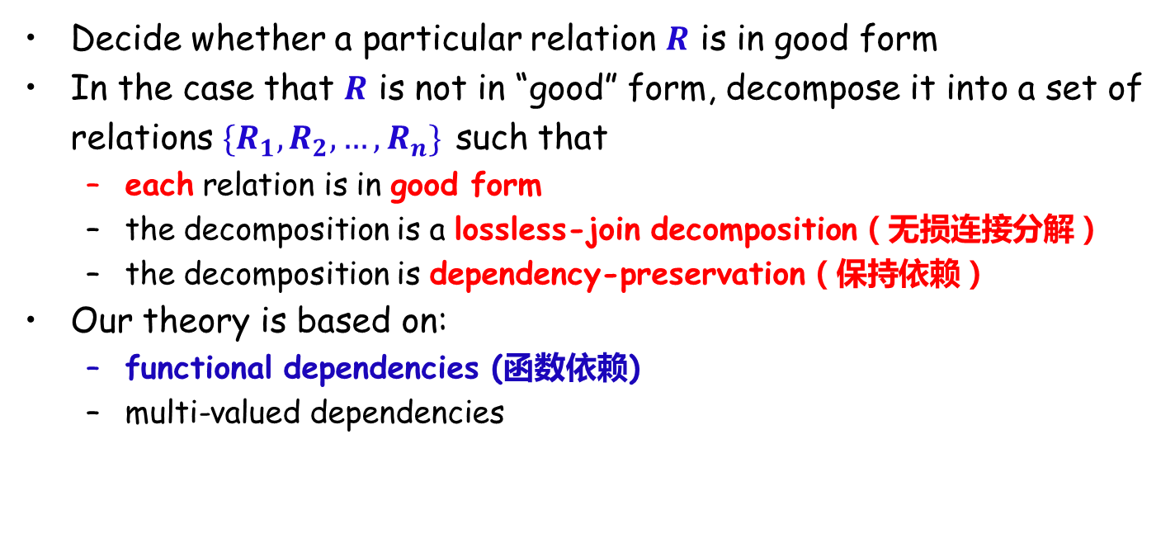
Goal - Devise a Theory for the Following
Decide whether a particular relation $R$ is in good form
In the case that $R$ is not in “good” form, decompose it into a set of relations $\{R_{1},R_{2},…,R_{n}\}$ such that
each relation is in good form
the decomposition is a lossless-join decomposition（无损连接分解）
the decomposition is dependency-preservation（保持依赖）
Our theory is based on:
functional dependencies (函数依赖)
multi-valued dependencies

Slide 16
Functional Dependencies (函数依赖)
Constraints on the set of legal relations
Require that the value for a certain set of attributes determines uniquely the value for another set of attributes
A functional dependency is a generalization of the notion of a key

Slide 17
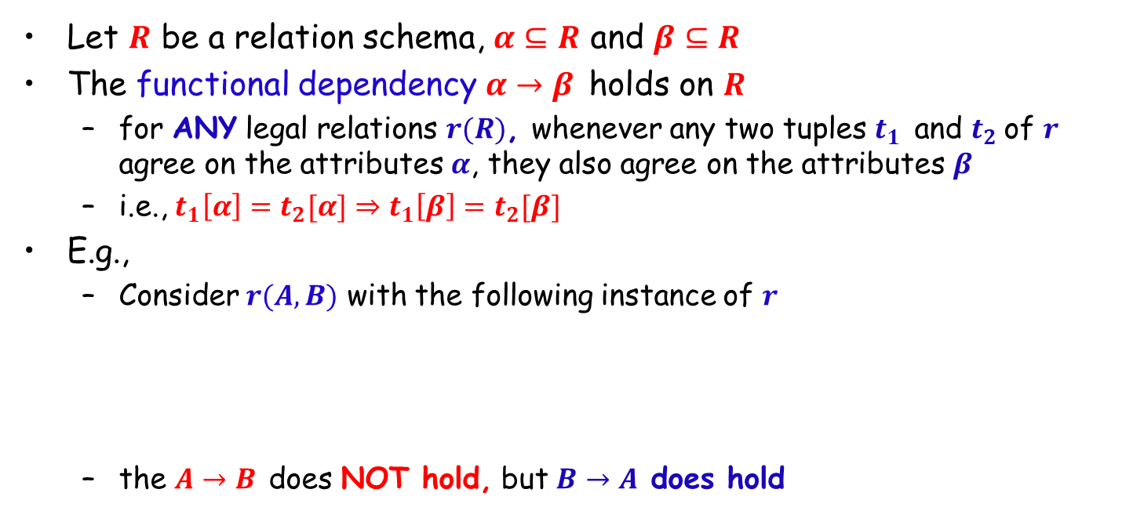
Functional Dependencies (Cont.)
Let $R$ be a relation schema, $α⊆R$ and $β⊆R$
The functional dependency $α→β$ holds on $R$
for ANY legal relations $r(R)$, whenever any two tuples $t_{1}$ and $t_{2}$of $r$ agree on the attributes $α$, they also agree on the attributes $β$
i.e., $t_{1}\left[α\right]=t_{2}[α]⇒t_{1}\left[β\right]=t_{2}[β]$
E.g.,
Consider $r(A,B)$ with the following instance of $r$
the $A→B$ does NOT hold, but $B→A$ does hold
4
1 5
3 7

Slide 18
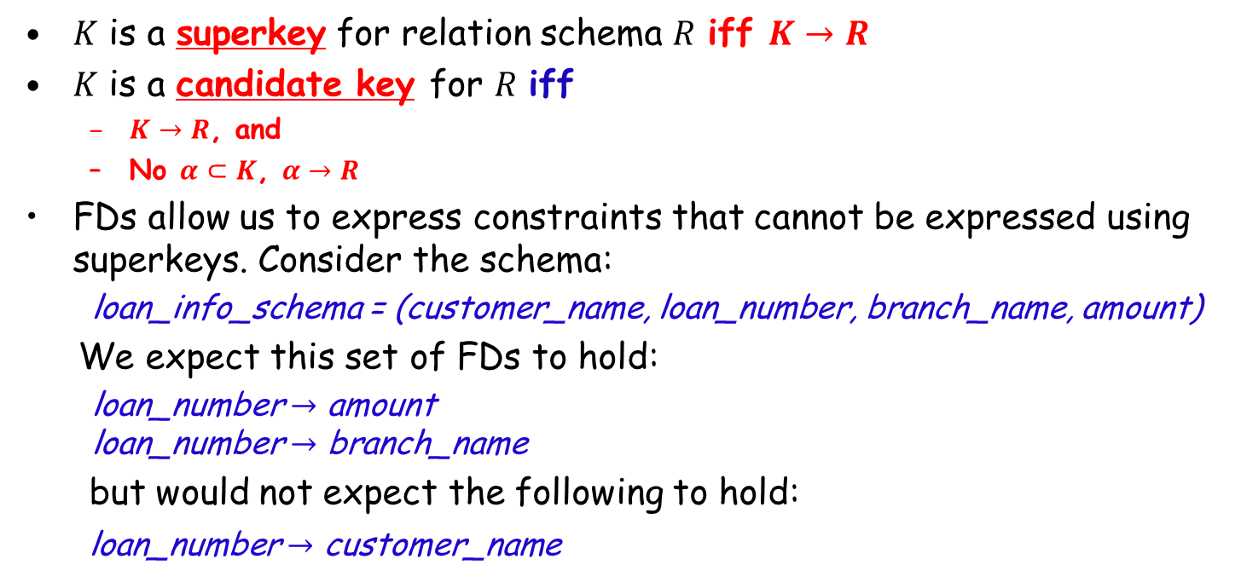
Functional Dependencies (Cont.)
$K$ is a superkey for relation schema $R$ iff $K→R$
$K$ is a candidate key for $R$ iff
$K→R$, and
No $α⊂K$, $α→R$
FDs allow us to express constraints that cannot be expressed using superkeys. Consider the schema:
loan_info_schema = (customer_name, loan_number, branch_name, amount)
We expect this set of FDs to hold:
loan_number $→$ amount loan_number $→$ branch_name
but would not expect the following to hold:
loan_number $→$ customer_name
Notes:
loan_number → customer_name
无法用superkey表示，因为custormername就是其属性之一

Slide 19
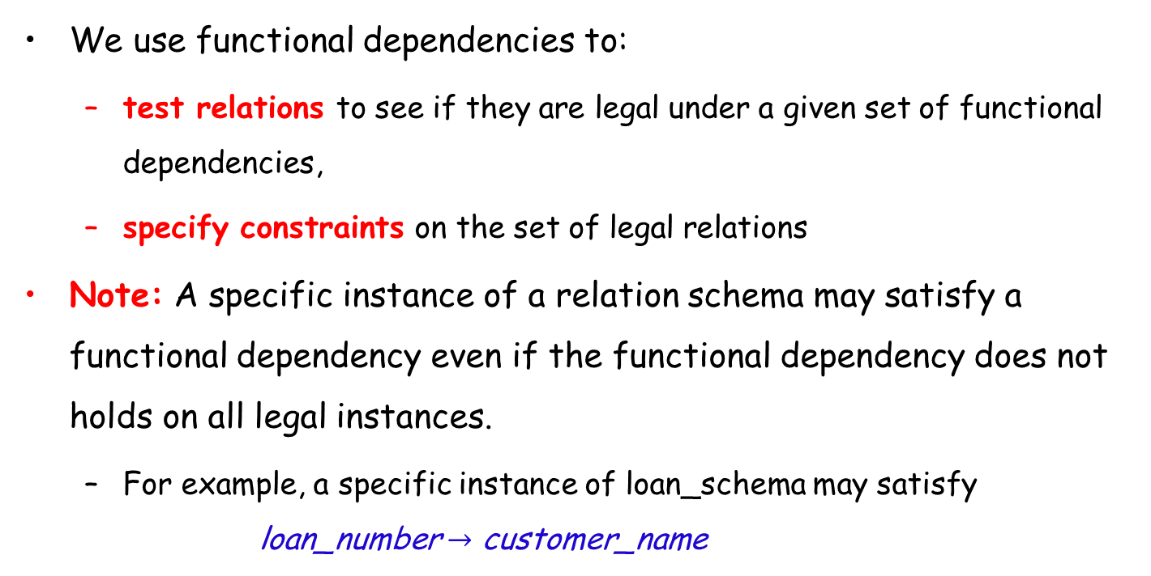
Applications of Functional Dependencies
We use functional dependencies to:
test relations to see if they are legal under a given set of functional dependencies,
specify constraints on the set of legal relations
Note: A specific instance of a relation schema may satisfy a functional dependency even if the functional dependency does not holds on all legal instances.
For example, a specific instance of loan_schema may satisfy loan_number $→$ customer_name

Slide 20
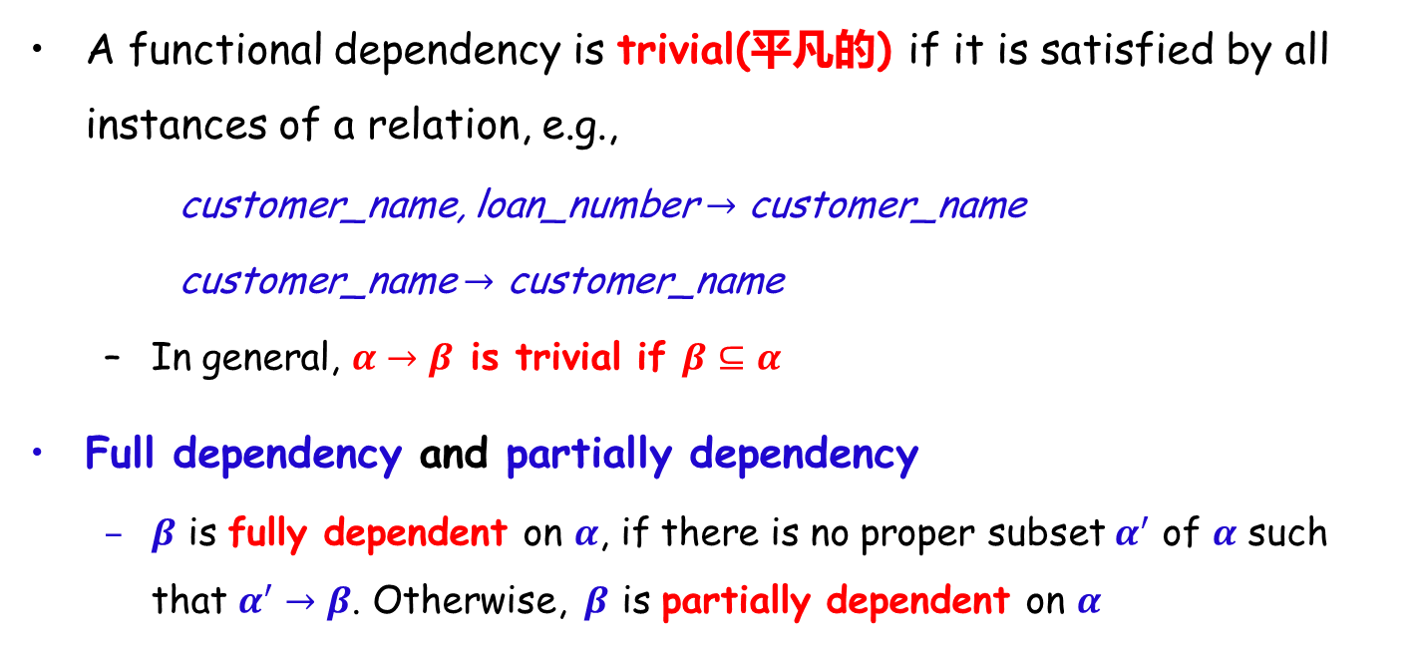
Functional Dependencies (Cont.)
A functional dependency is trivial(平凡的) if it is satisfied by all instances of a relation, e.g.,
customer_name, loan_number $→$ customer_name
customer_name $→$ customer_name
In general, $α→β$ is trivial if $β⊆α$
Full dependency and partially dependency
$β$ is fully dependent on $α$, if there is no proper subset $α^{′}$ of $α$ such that $α^{′}→β$. Otherwise, $β$ is partially dependent on $α$

Slide 21
Outline
Features of Good Relational Designs
☞ Functional Dependency/函数依赖
Decomposition using functional dependency
☞ Closure of functional dependency
Closure of attribute sets
Canonical cover
Lossless-join decomposition
Dependency preservation
Normalization & Normal Forms (范式)
Multivalued Dependencies*
Database Design Process

Slide 22
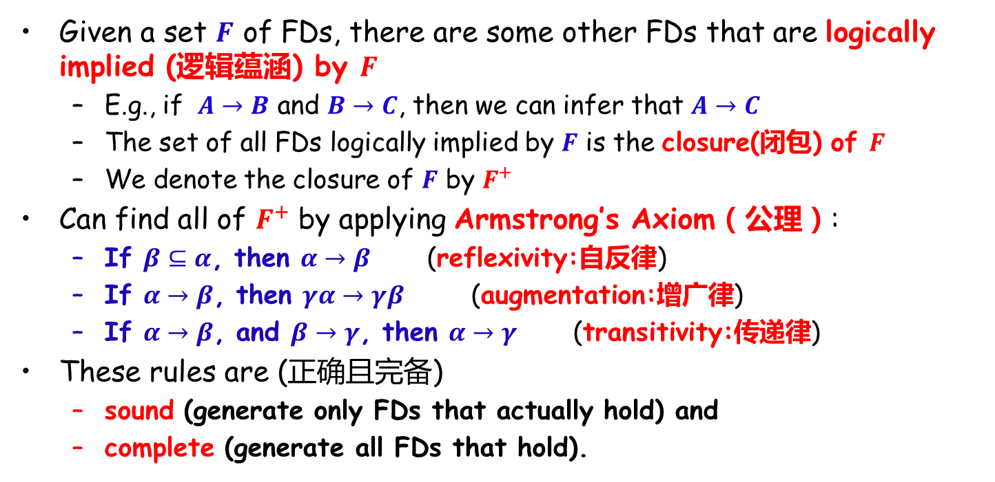
Closure of a Set of Functional Dependencies
Given a set $F$ of FDs, there are some other FDs that are logically implied (逻辑蕴涵) by $F$
E.g., if $A→B$ and $B→C$, then we can infer that $A→C$
The set of all FDs logically implied by $F$ is the closure(闭包) of $F$
We denote the closure of $F$ by $F^{+}$
Can find all of $F^{+}$ by applying Armstrong’s Axiom（公理）:
If $β⊆α$, then $α→β$ (reflexivity:自反律)
If $α→β$, then $γα→γβ$ (augmentation:增广律)
If $α→β$, and $β→γ$, then $α→γ$ (transitivity:传递律)
These rules are (正确且完备)
sound (generate only FDs that actually hold) and
complete (generate all FDs that hold).

Slide 23
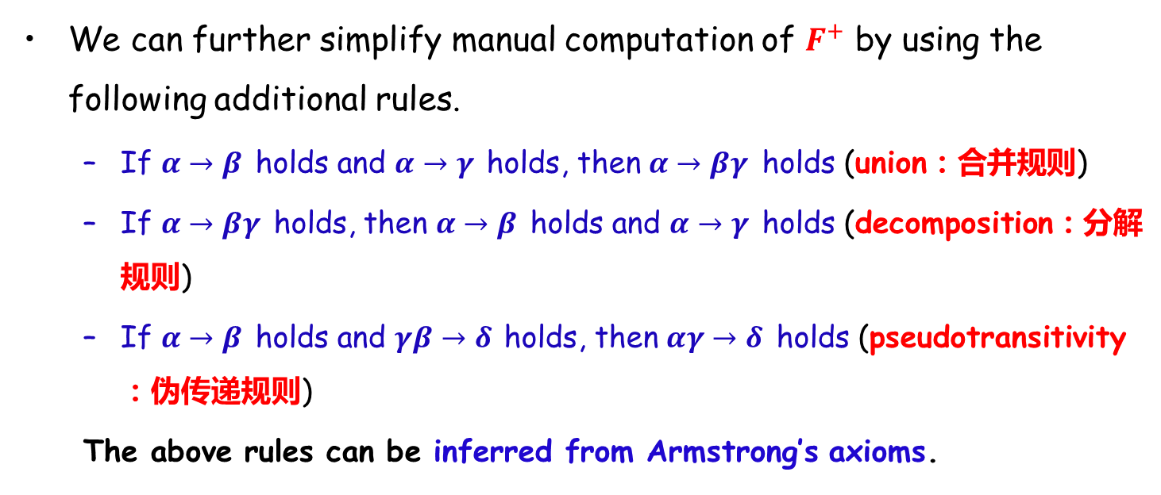
Closure of Functional Dependencies (Cont.)
We can further simplify manual computation of $F^{+}$ by using the following additional rules.
If $α→β$ holds and $α→γ$ holds, then $α→βγ$ holds (union：合并规则)
If $α→βγ$ holds, then $α→β$ holds and $α→γ$ holds (decomposition：分解规则)
If $α→β$ holds and $γβ→δ$ holds, then $αγ→δ$ holds (pseudotransitivity：伪传递规则)
The above rules can be inferred from Armstrong’s axioms.
Notes:
(1) $α→β$ , then$α→αβ$ ;
$α→γ$ , then$αβ→βγ$ ; then$α→βγ$
(2) $α→βγ$,
$βγ→β, βγ→γ$; then $α→β$ and$α→γ$
(3)$α→β$ , then $αγ→βγ$
$γβ→δ$ , then$αγ→δ$

Slide 24
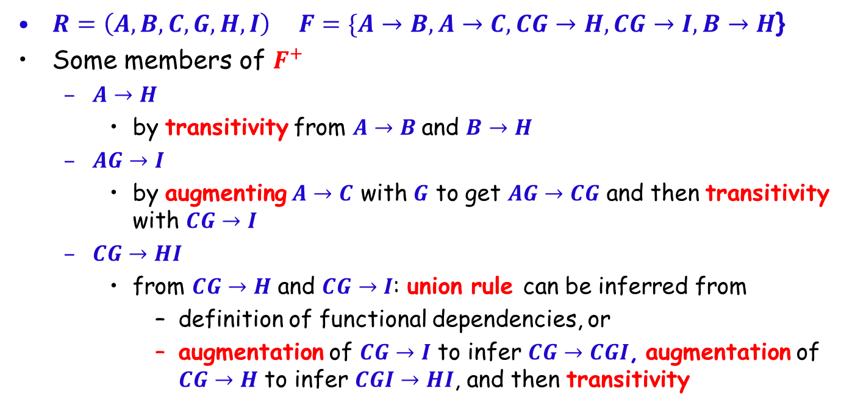
Example
$R=\left(A,B,C,G,H,I\right) F=\{A→B,A→C,CG→H,CG→I, B→H$}
Some members of $F^{+}$
$A→H$
by transitivity from $A→B$and $B→H$
$AG→I$
by augmenting $A→C$ with $G$ to get $AG→CG$ and then transitivity with $CG→I$
$CG→HI$
from $CG→H$ and $CG→I$: union rule can be inferred from
definition of functional dependencies, or
augmentation of $CG→I$ to infer $CG→CGI$, augmentation of $CG→H$ to infer $CGI→HI$, and then transitivity

Slide 25
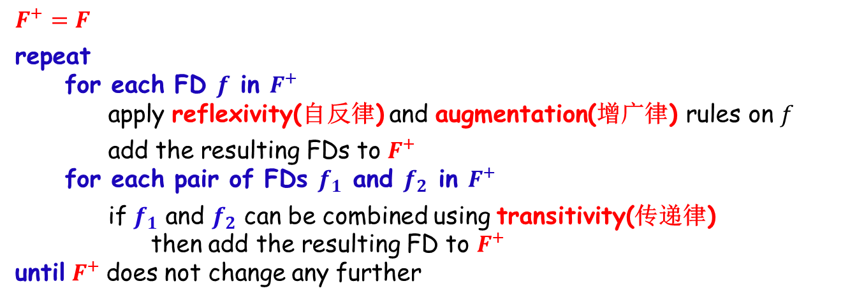
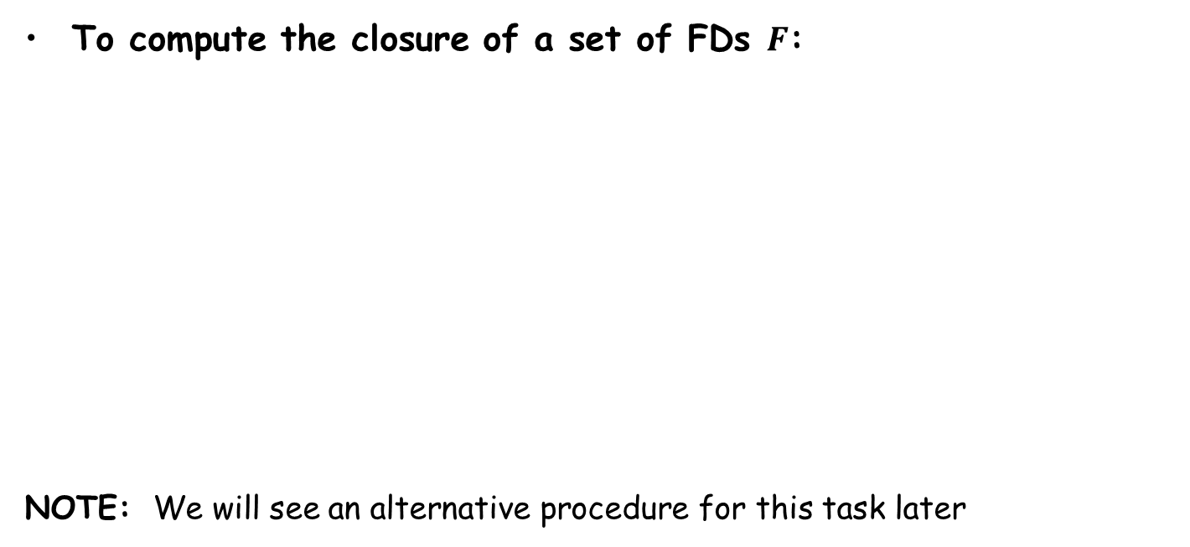
Procedure for Computing $F^{+}$
To compute the closure of a set of FDs $F$:
NOTE: We will see an alternative procedure for this task later
$$F^{+}=F$$ repeat for each FD $f$ in $F^{+}$ apply reflexivity(自反律) and augmentation(增广律) rules on $f$
add the resulting FDs to $F^{+}$ for each pair of FDs $f_{1}$ and $f_{2}$ in $F^{+}$
if $f_{1}$ and $f_{2}$ can be combined using transitivity(传递律) then add the resulting FD to $F^{+}$ until $F^{+}$does not change any further

Slide 26
$$F^{+}$$
R(X,Y,Z), F = {X→Y, Y→Z}, F⁺ ？
F⁺ = {
X→ Φ, Y→ Φ, Z→ Φ, XY→ Φ, XZ→ Φ, YZ→ Φ, XYZ→ Φ,
X→X, Y→Y, Z→Z, XY→X, XZ→X, YZ→Y, XYZ→X,
X→Y, Y→Z, XY→Y, XZ→Y, YZ→Z, XYZ→Y,
X→Z, Y→YZ, XY→Z, XZ→Z, YZ→YZ, XYZ→Z,
X→XY, XY→XY, XZ→XY, XYZ→XY,
X→XZ, XY→YZ, XZ→XZ, XYZ→YZ,
X→YZ, XY→XZ, XZ→YZ, XYZ→XZ,
X→XYZ, XY→XYZ, XZ→XYZ, XYZ→XYZ}
F={X→A1, …… , X→An}, to compute F⁺ is a NP problem
cv

Slide 27
Outline
Features of Good Relational Designs
☞ Functional Dependencies
Decomposition using Functional Dependencies
Closure of Functional Dependencies
☞ Closure of Attribute Sets
Canonical Cover
Lossless-join Decomposition
Dependency Preservation
Normalization & Normal Forms (范式)
Multivalued Dependencies*
Database Design Process

Slide 28
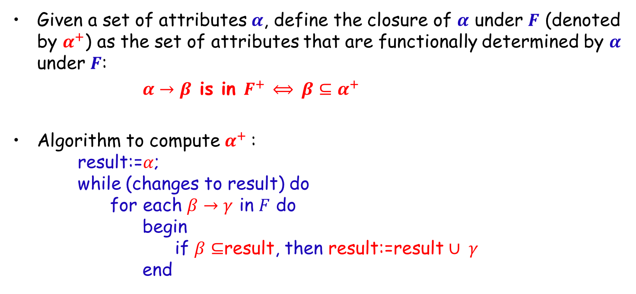
Closure of Attribute Sets
Given a set of attributes $α$, define the closure of $α$ under $F$ (denoted by $α^{+}$) as the set of attributes that are functionally determined by $α$ under $F$:
$α→β$ is in $F^{+}$ $⟺$ $β⊆α^{+}$
Algorithm to compute $α^{+}$: result:=$α$; while (changes to result) do for each $β→γ$ in $F$ do begin if $β⊆$result, then result:=result $∪ γ$ end

Slide 29
Example of Attribute Set Closure
Given R<U,F>, U = {A,B,C,D,E}, F={AB→C,B→D,C→E,EC→B,AC→B};
Compute: (AB)_{F}⁺,(AC)_{F}⁺,(EC)_{F}⁺
X⁽⁰⁾={A，B}；
First loop:
X⁽¹⁾: for each FD in F, find FDs that the left hand side(LHS) is A,B or AB, then AB→C,B→D, and X⁽¹⁾={A,B}∪{C,D}={A,B,C,D};
Second loop:
X⁽¹⁾≠X⁽⁰⁾, find FDs that the left hand side is the subset of {ABCD}, then AB→C,B→D,C→E,AC→B, and X⁽²⁾=X⁽¹⁾∪{C,D,E,B}={A,B,C,D,E};
X⁽²⁾=U, all attributes are in X⁽²⁾, the attribute set closure computing is end.
So (AB)_{F}⁺ = {A,B,C,D,E}.
(AC)_{F}⁺ = ??? (EC)_{F}⁺ = ???
(AC)_{F}⁺ = {A,B,C,D,E}； (EC)_{F}⁺ = {B,C,D,E}
Note：观察属性在函数依赖集中的情况，如何确定超码、候选码，有何规律？
Notes:
关注：A仅在左侧出现，D仅在右侧出现，BCE在左右都出现
AB、AC可以得到R，至少是超码，是否候选码？
再检查(A)_{F}⁺ =A，(B)_{F}⁺ =BD，(C)_{F}⁺ =CEBD
AB、AC是候选码
A仅在左侧出现，必须在候选码中出现！

Slide 30
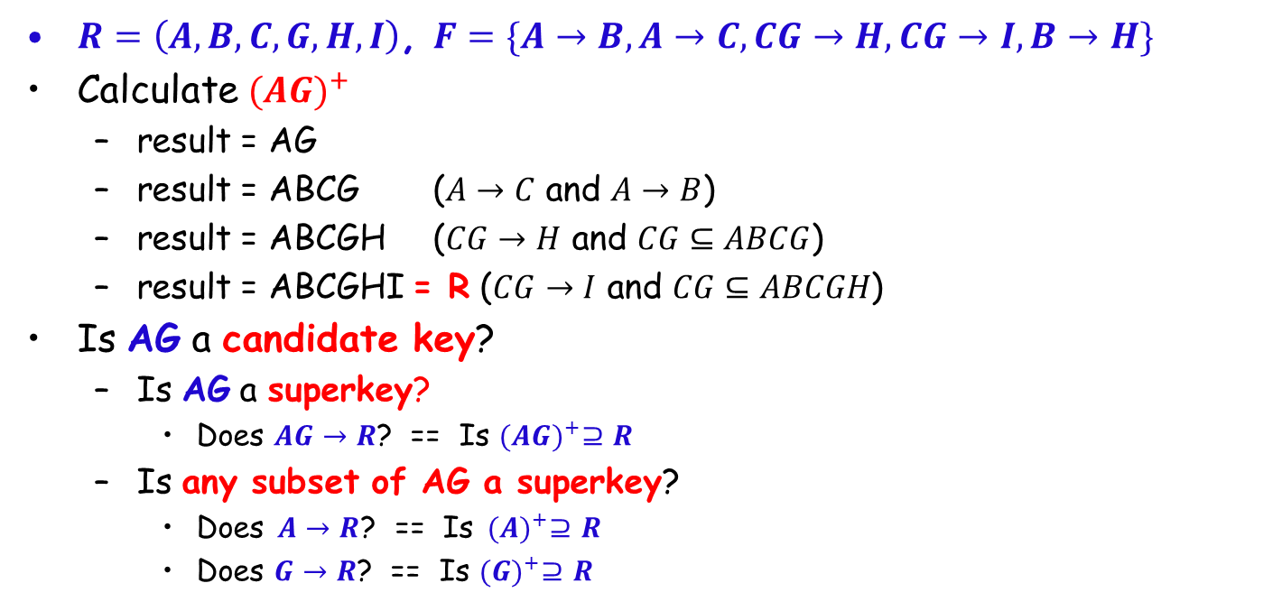
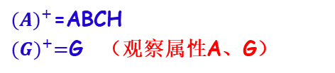
Example of Attribute Set Closure
$R=\left(A,B,C,G,H,I\right)$, $F=\{A→B,A→C,CG→H,CG→I,B→H\}$
Calculate ${(AG)}^{+}$
result = AG
result = ABCG ($A→C$ and $A→B$)
result = ABCGH ($CG→H$ and $CG⊆ABCG$)
result = ABCGHI = R ($CG→I$ and $CG⊆ABCGH$)
Is AG a candidate key?
Is AG a superkey?
Does $AG→R$? == Is ${(AG)}^{+}⊇R$
Is any subset of AG a superkey?
Does $A→R$? == Is ${(A)}^{+}⊇R$
Does $G→R$? == Is ${(G)}^{+}⊇R$
${(A)}^{+}$=ABCH
${(G)}^{+}=$G （观察属性A、G）
Notes:
${ (A)}^{+}$=ABCH
${(G)}^{+}=$G （观察属性G）

Slide 31
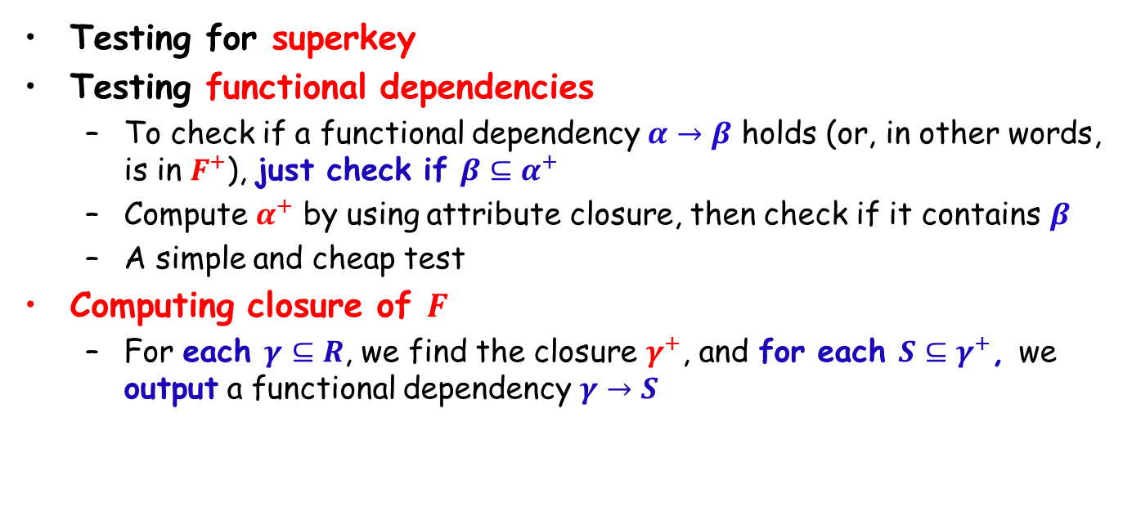
Applications of Attribute Closure
Testing for superkey
Testing functional dependencies
To check if a functional dependency $α→β$ holds (or, in other words, is in $F^{+}$), just check if $β⊆α^{+}$
Compute $α^{+}$ by using attribute closure, then check if it contains $β$
A simple and cheap test
Computing closure of $F$
For each $γ⊆R$, we find the closure $γ^{+}$, and for each $S⊆γ^{+}$, we output a functional dependency $γ→S$

Slide 32
Outline
Features of Good Relational Designs
☞ Functional Dependencies
Decomposition using Functional Dependencies
Closure of Functional Dependencies
Closure of Attribute Sets
☞ Canonical Cover
Lossless-join Decomposition
Dependency Preservation
Normalization & Normal Forms (范式)
Multivalued Dependencies*
Database Design Process

Slide 33
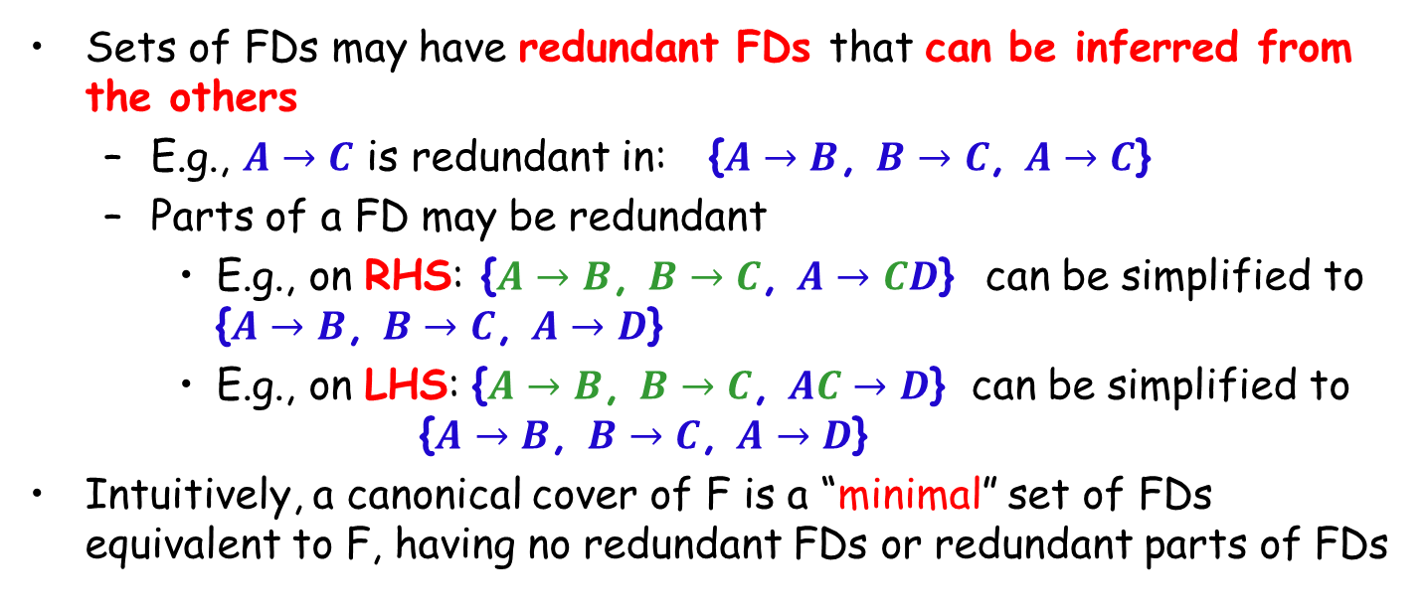
Canonical Cover (正则覆盖/最小覆盖)
Sets of FDs may have redundant FDs that can be inferred from the others
E.g., $A→C$ is redundant in: {$A→B$, $B→C$, $A→C$}
Parts of a FD may be redundant
E.g., on RHS: {$A→B$, $B→C$, $A→CD$} can be simplified to {$A→B$, $B→C$, $A→D$}
E.g., on LHS: {$A→B$, $B→C$, $AC→D$} can be simplified to {$A→B$, $B→C$, $A→D$}
Intuitively, a canonical cover of F is a “minimal” set of FDs equivalent to F, having no redundant FDs or redundant parts of FDs

Slide 34
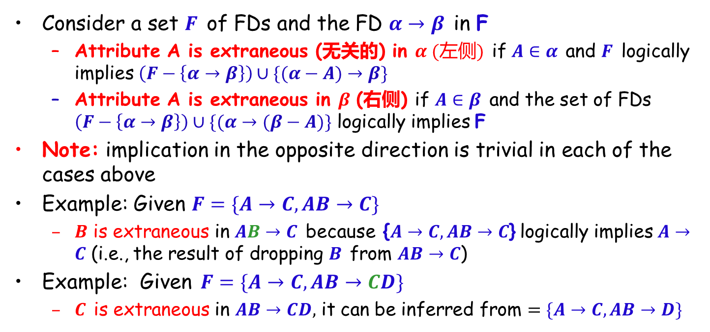
Extraneous Attributes (无关属性)
Consider a set $F$ of FDs and the FD $α→β$ in F
Attribute A is extraneous (无关的) in $α (左侧)$ if $A∈α$ and $F$ logically implies $\left(F−\left\{α→β\right\}\right)∪\{(α−A)→β\}$
Attribute A is extraneous in $β$ (右侧) if $A∈β$ and the set of FDs $\left(F−\left\{α→β\right\}\right)∪\{(α→(β−A)\}$ logically implies F
Note: implication in the opposite direction is trivial in each of the cases above
Example: Given $F=\{A→C, AB→C\}$
$B$ is extraneous in $AB→C$ because {$A→C, AB→C$} logically implies $A→C$ (i.e., the result of dropping $B$ from $AB→C$)
Example: Given $F=\{A→C, AB→CD\}$
$C$ is extraneous in $AB→CD,$ it can be inferred from $=\{A→C, AB→D\}$
Notes:
F logically implies (F – {α→β}) ∪ {(α–A) → β}.或者： (F – {α→β}) ∪ {(α–A) → β} logically implies F .是一样的。

Slide 35
Testing if an Attribute is Extraneous
Consider a set F of FDs and α→β in F.
To test if attribute A∈α is extraneous in α (左侧LHS)
compute ({α} – A)⁺ using the dependencies in F
check that ({α} – A)⁺ contains β; if it does, A is extraneous
To test if attribute A∈β is extraneous in β (右侧RHS)
compute α⁺ using only the dependencies in F’ = (F – {α→β}) ∪ {α→(β – A)},
check that α⁺ contains A; if it does, A is extraneous

Slide 36
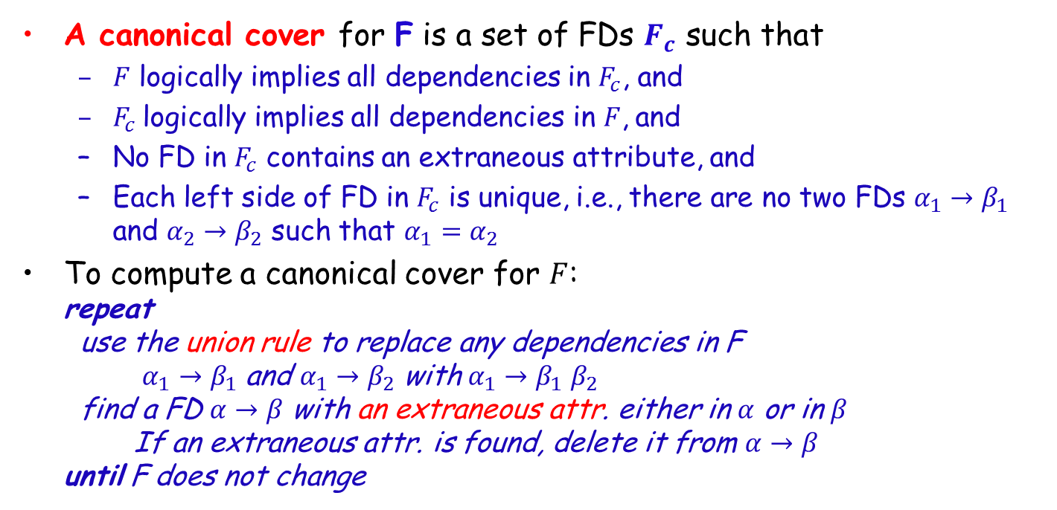
Canonical Cover
A canonical cover for F is a set of FDs $F_{c}$ such that
$F$ logically implies all dependencies in $F_{c}$, and
$F_{c}$logically implies all dependencies in $F$, and
No FD in $F_{c}$ contains an extraneous attribute, and
Each left side of FD in $F_{c}$ is unique, i.e., there are no two FDs $α_{1}{→β}_{1}$ and $α_{2}{→β}_{2}$ such that $α_{1}=α_{2}$
To compute a canonical cover for $F$: repeat use the union rule to replace any dependencies in F $α_{1}{→β}_{1}$ and $α_{1}{→β}_{2}$ with $α_{1}{→β}_{1}β_{2}$ find a FD $α→β$ with an extraneous attr. either in $α$ or in $β$ If an extraneous attr. is found, delete it from $α→β$ until F does not change

Slide 37
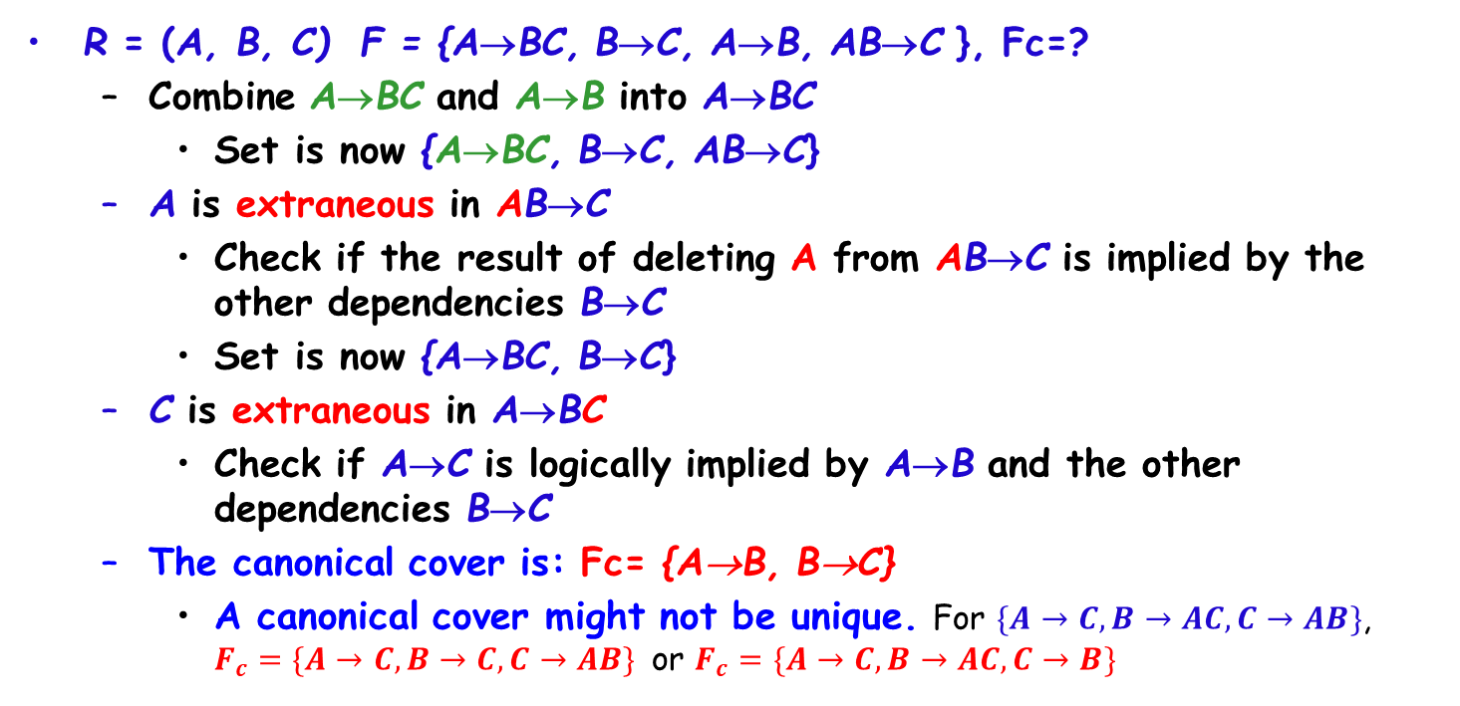
Example of Computing a Canonical Cover
R = (A, B, C) F = {A→BC, B→C, A→B, AB→C }, Fc=?
Combine A→BC and A→B into A→BC
Set is now {A→BC, B→C, AB→C}
A is extraneous in AB→C
Check if the result of deleting A from AB→C is implied by the other dependencies B→C
Set is now {A→BC, B→C}
C is extraneous in A→BC
Check if A→C is logically implied by A→B and the other dependencies B→C
The canonical cover is: Fc= {A→B, B→C}
A canonical cover might not be unique. For $\{A→C, B→AC, C→AB\}$, $F_{c}=\{A→C, B→C, C→AB\}$ or $F_{c}=\{A→C, B→AC, C→B\}$

Slide 38
Example of Computing a Canonical Cover
R<U,F>, U={A,B,C}, F={A→BC, B→C, A→B, AB→C}. F_{c} or F_{m} ?
1) For each FD in F：F={A→B,A→C,B→C,A→B,AB→C}
2) A→B can be deleted, then F={A→B, A→C, B→C, AB→C}
3) For A→C, is implied by A→B and B→C, so A→C is extraneous, then F={A→B, B→C, AB→C}
4) AB→C is implied by B→C, then AB→C is extraneous, so we have F={A→B, B→C}. And that is F_{c} or F_{m。}

Slide 39
Example of Computing a Canonical Cover
R<U,F>, U={X,Y,Z,W},
F={W→Y,Y→W,X→WY,Z→WY,XZ→W}, F_{c}?
(1) F={W→Y,Y→W,X→W,X→Y,Z→W,Z→Y,XZ→W}
(2) For LHS, F={W→Y,Y→W,X→W,X→Y,Z→W,Z→Y}
(3) Delete redundant FDs,F={W→Y,Y→W,X→Y,Z→Y}
Fc = {W→Y,Y→W,X→Y,Z→Y}
or Fc = {W→Y,Y→W,X→W,Z→W}

Slide 40
Example of Computing a Canonical Cover
F = {A→B，B→A，B→C，A→C，C→A}
F_{c1}= {A→B，B→C，C→A}
F_{c2}= {A→B，B→A，A→C，C→A}
F_{c1}、F_{c2} are all canonical covers for F
So, a canonical cover might not be unique

Slide 41
More Examples
R<U,F>, U={A,B,C,D,E,G},
F={AB→C, C→A, BC→D, ACD→B, D→EG, BE→C, CG→BD, CE→AG}，
Compute (AB)⁺, (AC)⁺, (CD)⁺, Fc
(AB)⁺={A,B,C,D,E,G}=U, (AC)⁺ ? (CD)⁺ ?
(AC)⁺={A,C}, (CD)⁺={A,B,C,D,E,G}=U
Fc={AB→C,C→A,BC→D,CD→B,D→E,D→G,BE→C,CG→D,CE→G}
(CG)⁺={A,B,C,D,E,G}=U, (CE)⁺={A,B,C,D,E,G}=U

Slide 42
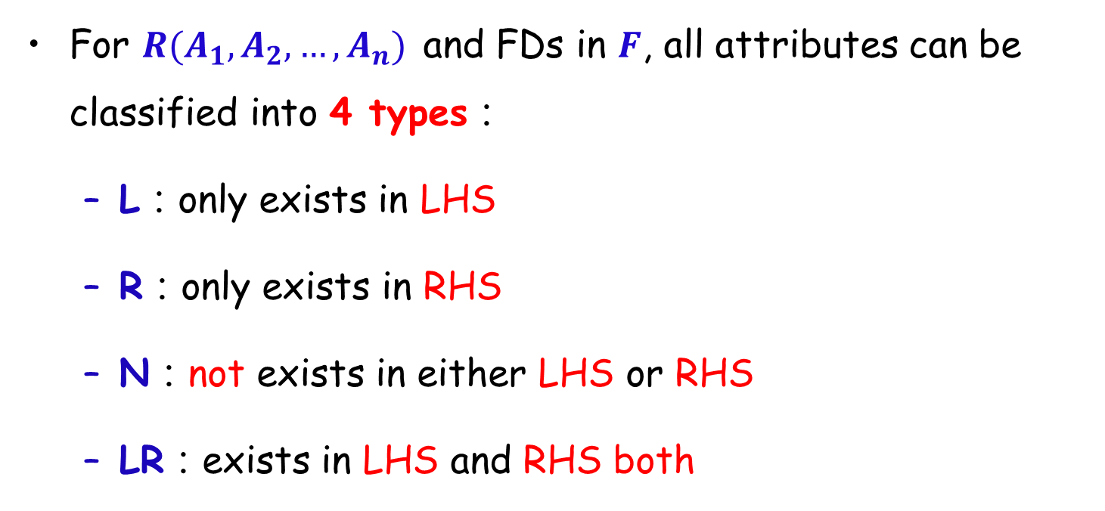
Find Candidate Keys
For $R(A_{1},A_{2},…,A_{n})$ and FDs in $F$, all attributes can be classified into 4 types：
L：only exists in LHS
R：only exists in RHS
N：not exists in either LHS or RHS
LR：exists in LHS and RHS both

Slide 43
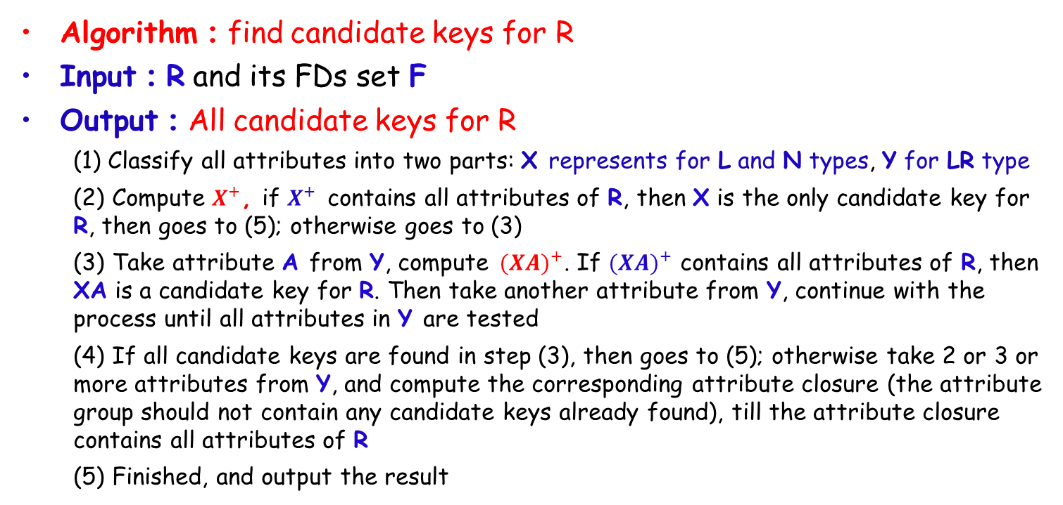
Find Candidate Keys (Cont.)
Algorithm：find candidate keys for R
Input：R and its FDs set F
Output：All candidate keys for R
(1) Classify all attributes into two parts: X represents for L and N types, Y for LR type
(2) Compute $X^{+}$, if $X^{+}$ contains all attributes of R, then X is the only candidate key for R, then goes to (5); otherwise goes to (3)
(3) Take attribute A from Y, compute ${(XA)}^{+}$. If ${(XA)}^{+}$ contains all attributes of R, then XA is a candidate key for R. Then take another attribute from Y, continue with the process until all attributes in Y are tested
(4) If all candidate keys are found in step (3), then goes to (5); otherwise take 2 or 3 or more attributes from Y, and compute the corresponding attribute closure (the attribute group should not contain any candidate keys already found), till the attribute closure contains all attributes of R
(5) Finished, and output the result

Slide 44
Find Candidate Keys (Cont.)
Given R<U, F>, U={X, Y, Z, W}, and F={W→Y, Y→W, X→WY, Z→WY, XZ→W}, find all candidate keys of R
F_{c} = {W→Y, Y→W, X→Y, Z→Y}
X_{LN} = X_{L} = XZ，Y_{LR} = YW
X_{LN}⁺ = {X,Y,Z,W} = U，so (XZ) is the only candidate key of R

Slide 45
Find Candidate Keys (Cont.)
Given R<U,F>, U={A,B,C,D}, and F={AB→C, C→D, D→A}, find all candidate keys of R
F_{c} = {AB→C, C→D, D→A}
X_{LN} = X_{L} = B，Y_{LR} = ACD
X_{LN}⁺ = {B} ≠ U
(AB)⁺ = {ABCD} = U, (BC)⁺ = {ABCD} = U, (BD)⁺ = {ABCD} = U, then (AB)、(BC)、(BD) are all candidate keys of R

Slide 46
Find Candidate Keys (Cont.)
Given R<U,F>, U={OBISQD}, F={S→D, D→S, I→B, B→I, B→O, O→B}, find all candidate keys of R
(1) F_{c}= { ？}
(2) X_{LN}= ？，Y_{LR}= ？
(3) X_{LN}⁺={ ？} = or ≠U？
(4) …… ，……
candidate keys of R ？
(QSO)、(QDO)、(QSB)、(QDB)、(QSI)、(QDI)

Slide 47
Find Candidate Keys (Cont.)
Given R<U,F>, U={OBISQD}, F={S→D, D→S, I→B, B→I, B→O, O→B}, find all candidate keys of R
(1) Fc={S→D, D→S, I→B, B→I, B→O, O→B}=F
(2) X_{LN}= Q，Y_{LR}= SDBIO
(3) X_{LN}⁺={Q} ≠U
(4)(QS)⁺={QSD},(QD)⁺={QSD},(QB)⁺={QBIO},(QI)⁺={QBIO},(QO)⁺={QBIO};
≠U
(QSO)⁺、(QSB)⁺、(QSI)⁺、(QSD)⁺ 、(QDO)⁺、(QDB)⁺、(QDI)⁺ 、(QDS)⁺、
(QBO)⁺、(QBI)⁺、(QBS)⁺、(QBD)⁺ 、(QIO)⁺、(QIB)⁺、(QSI)⁺、(QID)⁺ 、
(QOB)⁺、(QOI)⁺、(QOS)⁺、(QOD)⁺ 、
candidate keys of R:
(QSO)、(QSB)、(QSI)、 (QDO)、 (QDB)、 (QDI)

Slide 48
Outline
Features of Good Relational Designs
☞ Functional Dependencies
Decomposition using Functional Dependencies
Closure of Functional Dependencies
Closure of Attribute Sets
Canonical Cover
☞ Lossless-join Decomposition
Dependency Preservation
Normalization & Normal Forms (范式)
Multivalued Dependencies*
Database Design Process

Slide 49
Goals of Normalization
Decide whether a particular relation R is in good form
In the case that R is not in “good” form, decompose it into a set of relations {R₁,R₂,...,R_{n}} such that
each relation is in good form
the decomposition is a lossless-join decomposition
the decomposition is dependency-preservation
Our theory is based on:
functional dependencies
Multi-valued dependencies

Slide 50
Decomposition
Decompose the relation schema Lending_schema into:
Branch_schema = (branch_name, branch_city,assets)
Loan_info_schema = (customer_name, loan_number, branch_name, amount)
All attributes of an original schema (R) must appear in the decomposition (R₁, R₂):
R = R₁ ∪ R₂
Lossless-join decomposition.For all possible relations r on schema R
r = ∏_{R1} (r) ∏_{R2} (r)
Theorem: A decomposition of R into R₁ and R₂ is lossless join iff at least one of the following dependencies is in F⁺:
R₁ ∩ R₂ → R₁
R₁ ∩ R₂ → R₂

Slide 51

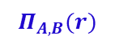

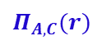
Example of Non Lossless-Join Decomposition
Decomposition of R = (A, B, C), F = {A → C, B → C)
R1 = (A,C), R2 = (B,C)
R₁ = (A,B) R₂ = (B,C)？
lossy
lossless
$$r$$
$$Π_{A,C}(r)$$
$$Π_{B,C}(r)$$
$$Π_{A,B}(r)$$
A | B | C
α | 1 | 1
α | 2 | 1
β | 1 | 1
A | C
α | 1
β | 1
B | C
1 | 1
2 | 1
A | B
αα | 1 2
β | 1
R₁ ∩ R₂ → R₂
∏_{AC} (r) ∏_{BC} (r)
∏_{AB} (r) ∏_{BC} (r)
A | B | C
α | 1 | 1
α | 2 | 1
β | 1 | 1
β | 2 | 1
$$r$$
R₁ ∩ R₂ → R₁ ?
R₁ ∩ R₂ → R₂ ?
A | B | C
α | 1 | 1
α | 2 | 1
β | 1 | 1

Slide 52
Example
R = (A, B, C) F = {A → B, B → C)
Can be decomposed in two different ways
R₁ = (A, B), R₂ = (B, C)
Lossless-join decomposition:
R₁ ∩ R₂ = {B} and B → BC
Dependency preserving
R₁ = (A, B), R₂ = (A, C)
Lossless-join decomposition:
R₁ ∩ R₂ = {A} and A → AB
Not dependency preserving (cannot check B → C without computing R₁ R₂)

Slide 53
Example
Given R<U,F>, U={A,B,C,D,E}, F={AB→C, C→D, D→E}, and a decomposition ρ of R into:
R1(A,B,C), R2(C,D), R3(D,E).
ρ is a lossless-join decomposition or a lossy one?

Slide 54
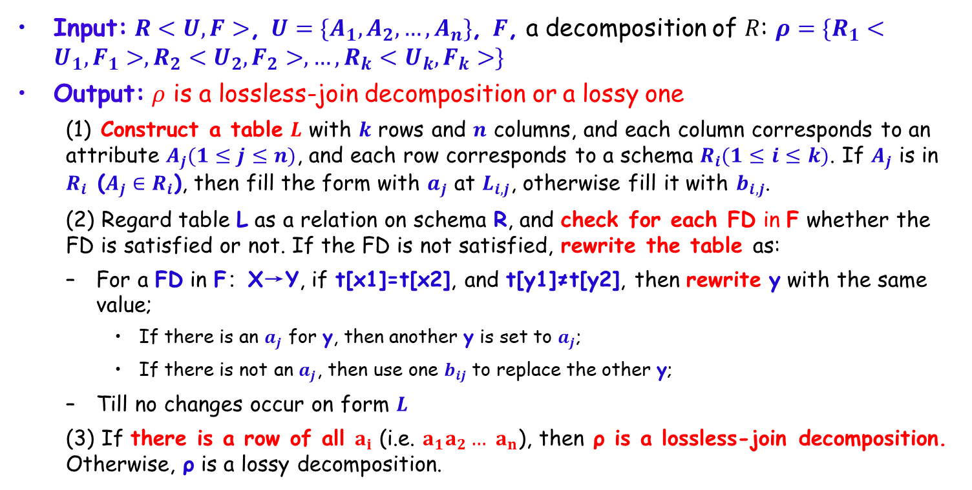
Test for Lossless-join Decomposition
Input: $R<U,F>$, $U=\{A_{1},A_{2},…,A_{n}\}$, $F$, a decomposition of $R$: $ρ=\{R_{1}<U_{1},F_{1}>,R_{2}<U_{2},F_{2}>,…,R_{k}<U_{k},F_{k}>\}$
Output: $ρ$ is a lossless-join decomposition or a lossy one
(1) Construct a table $L$ with $k$ rows and $n$ columns, and each column corresponds to an attribute $A_{j}(1≤j≤n)$, and each row corresponds to a schema $R_{i}(1≤i≤k)$. If $A_{j}$ is in $R_{i}$ (${A_{j}∈R}_{i}$), then fill the form with $a_{j}$ at $L_{i,j}$, otherwise fill it with $b_{i,j}$.
(2) Regard table L as a relation on schema R, and check for each FD in F whether the FD is satisfied or not. If the FD is not satisfied, rewrite the table as:
For a FD in F：X→Y, if t[x1]=t[x2], and t[y1]≠t[y2], then rewrite y with the same value;
If there is an $a_{j}$ for y, then another y is set to $a_{j}$;
If there is not an $a_{j}$, then use one $b_{ij}$ to replace the other y;
Till no changes occur on form $L$
(3) If there is a row of all $a_{i}$ (i.e. $a_{1}a_{2}…$ $a_{n}$), then ρ is a lossless-join decomposition. Otherwise, ρ is a lossy decomposition.

Slide 55
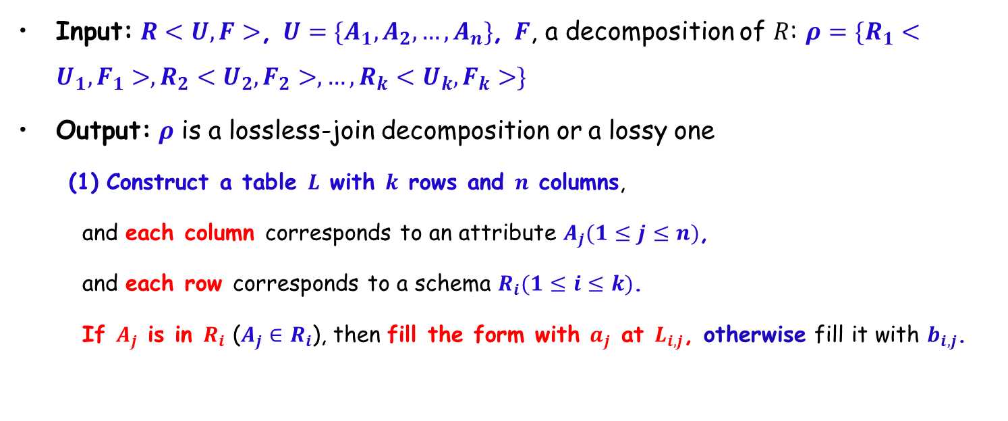
Test for Lossless-join Decomposition
Input: $R<U,F>$, $U=\{A_{1},A_{2},…,A_{n}\}$, $F$, a decomposition of $R$: $ρ=\{R_{1}<U_{1},F_{1}>,R_{2}<U_{2},F_{2}>,…,R_{k}<U_{k},F_{k}>\}$
Output: $ρ$ is a lossless-join decomposition or a lossy one
Construct a table $L$ with $k$ rows and $n$ columns,
and each column corresponds to an attribute $A_{j}(1≤j≤n)$,
and each row corresponds to a schema $R_{i}(1≤i≤k)$.
If $A_{j}$ is in $R_{i}$ (${A_{j}∈R}_{i}$), then fill the form with $a_{j}$ at $L_{i,j}$, otherwise fill it with $b_{i,j}$.

Slide 56
Example
Given R<U,F>, U={A,B,C,D,E}, F={AB→C, C→D, D→E}, and a decomposition ρ of R into: R1(A, B, C), R2(C, D), R3(D, E). ρ is a lossless-join decomposition or a lossy one?
(1) First, construct a table as:
 | A | B | C | D | E
R1(A,B,C) | a₁ | a₂ | a₃ | b₁₄ | b₁₅
R2(C,D) | b₂₁ | b₂₂ | a₃ | a₄ | b₂₅
R3(D,E) | b₃₁ | b₃₂ | b₃₃ | a₄ | a₅

Slide 57
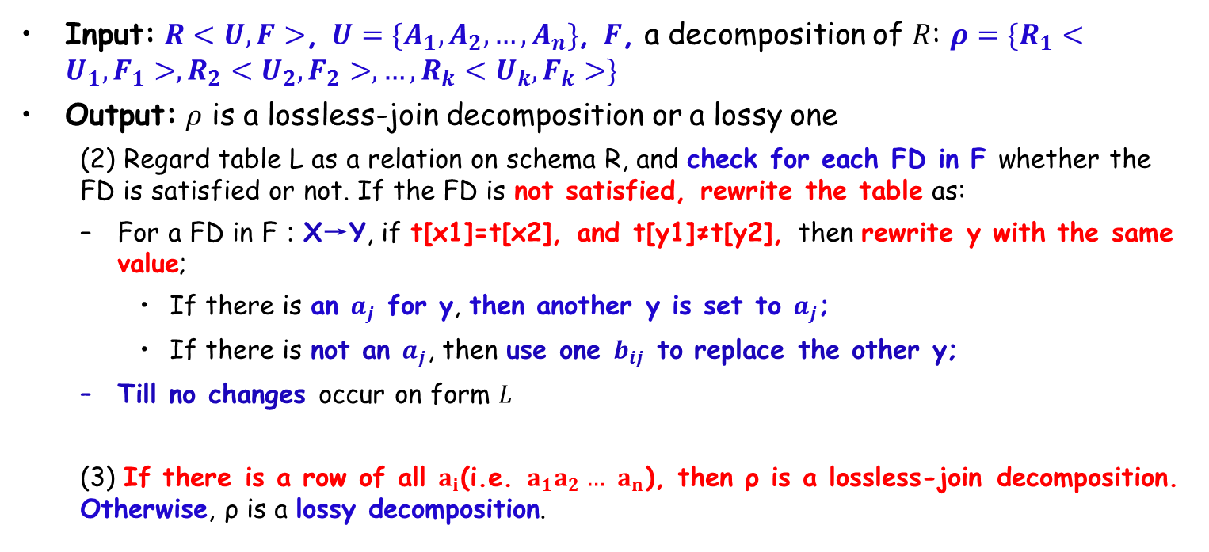
Test for Lossless-join Decomposition
Input: $R<U,F>$, $U=\{A_{1},A_{2},…,A_{n}\}$, $F$, a decomposition of $R$: $ρ=\{R_{1}<U_{1},F_{1}>,R_{2}<U_{2},F_{2}>,…,R_{k}<U_{k},F_{k}>\}$
Output: $ρ$ is a lossless-join decomposition or a lossy one
(2) Regard table L as a relation on schema R, and check for each FD in F whether the FD is satisfied or not. If the FD is not satisfied, rewrite the table as:
For a FD in F：X→Y, if t[x1]=t[x2], and t[y1]≠t[y2], then rewrite y with the same value;
If there is an $a_{j}$ for y, then another y is set to $a_{j}$;
If there is not an $a_{j}$, then use one $b_{ij}$ to replace the other y;
Till no changes occur on form $L$
(3) If there is a row of all $a_{i}$(i.e. $a_{1}a_{2}…$ $a_{n}$), then ρ is a lossless-join decomposition. Otherwise, ρ is a lossy decomposition.

Slide 58
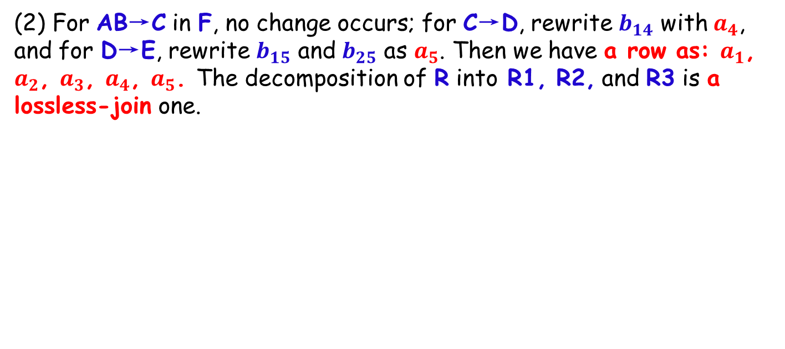
Example (cont.)
(2) For AB→C in F, no change occurs; for C→D, rewrite $b_{14}$ with $a_{4}$, and for D→E, rewrite $b_{15}$ and $b_{25}$ as $a_{5}$. Then we have a row as: $a_{1}$, $a_{2}$, $a_{3}$, $a_{4}$, $a_{5}$. The decomposition of R into R1, R2, and R3 is a lossless-join one.
 | A | B | C | D | E
R1(A,B,C) | a₁ | a₂ | a₃ | _{b14} a₄ | _{b15} a₅
R2(C,D) | b₂₁ | b₂₂ | a₃ | a₄ | _{b25} a₅
R3(D,E) | b₃₁ | b₃₂ | b₃₃ | a₄ | a₅

Slide 59
Example of Non Lossless-Join Decomposition
Decomposition of R = (A, B, C), F = {A → C, B → C)
R1 = (A,C), R2 = (B,C)
R₁ = (A,B) R₂ = (B,C)？
lossy
lossless
$$r$$
$$Π_{A,C}(r)$$
$$Π_{B,C}(r)$$
$$Π_{A,B}(r)$$
A | B | C
α | 1 | 1
α | 2 | 1
β | 1 | 1
A | C
α | 1
β | 1
B | C
1 | 1
2 | 1
A | B
αα | 1 2
β | 1
R₁ ∩ R₂ → R₂
∏_{AC} (r) ∏_{BC} (r)
∏_{AB} (r) ∏_{BC} (r)
A | B | C
α | 1 | 1
α | 2 | 1
β | 1 | 1
β | 2 | 1
$$r$$
R₁ ∩ R₂ → R₁ ?
R₁ ∩ R₂ → R₂ ?
A | B | C
α | 1 | 1
α | 2 | 1
β | 1 | 1

Slide 60
Example
R = (A, B, C) F = {A → B, B → C)
Can be decomposed in two different ways
R₁ = (A, B), R₂ = (B, C)
Lossless-join decomposition:
R₁ ∩ R₂ = {B} and B → BC
Dependency preserving
R₁ = (A, B), R₂ = (A, C)
Lossless-join decomposition:
R₁ ∩ R₂ = {A} and A → AB
Not dependency preserving (cannot check B → C without computing R₁ R₂)

Slide 61
More Examples
R<U,F>, U={A,B,C,D,E}, F={A→C, B→C, C→D, DE→C, CE→A}, and a decomposition of R: ρ={R1(A,D), R2(A,B), R3(B,E), R4(C,D,E), R5(A,E)}. ρ is a lossless-join decomposition or a lossy one ?
ρ is a lossless-join decomposition
R<U,F>, U={A,B,C,D}, F={A→B, A→C, C→D}, ρ={R1(A,B), R2(B,C), R3(C,D)}. ρ is a lossless-join decomposition or a lossy one?
ρ is a lossy-join decomposition

Slide 62
Outline
Features of Good Relational Designs
☞ Functional Dependencies
Decomposition using Functional Dependencies
Closure of Functional Dependencies
Closure of Attribute Sets
Canonical Cover
Lossless-join Decomposition
☞ Dependency Preservation
Normalization & Normal Forms (范式)
Multivalued Dependencies*
Database Design Process

Slide 63
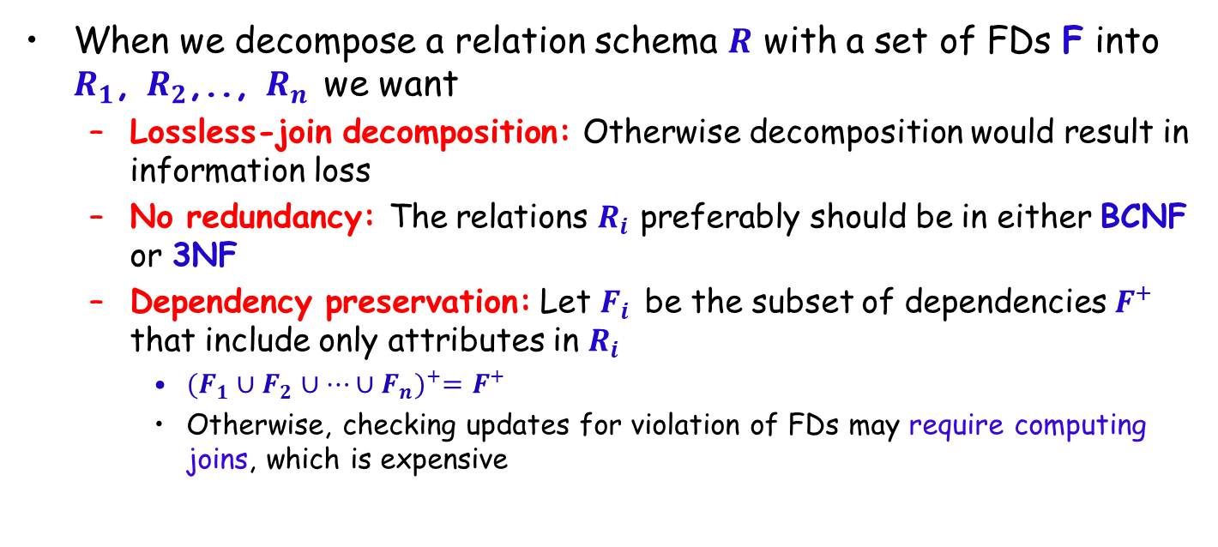
Normalization using Functional Dependencies
When we decompose a relation schema $R$ with a set of FDs F into $R_{1}$, $R_{2}$,.., $R_{n}$ we want
Lossless-join decomposition: Otherwise decomposition would result in information loss
No redundancy: The relations $R_{i}$ preferably should be in either BCNF or 3NF
Dependency preservation: Let $F_{i}$ be the subset of dependencies $F^{+}$ that include only attributes in $R_{i}$
${(F_{1}∪F_{2}∪…∪F_{n})}^{+}=F^{+}$
Otherwise, checking updates for violation of FDs may require computing joins, which is expensive

Slide 64
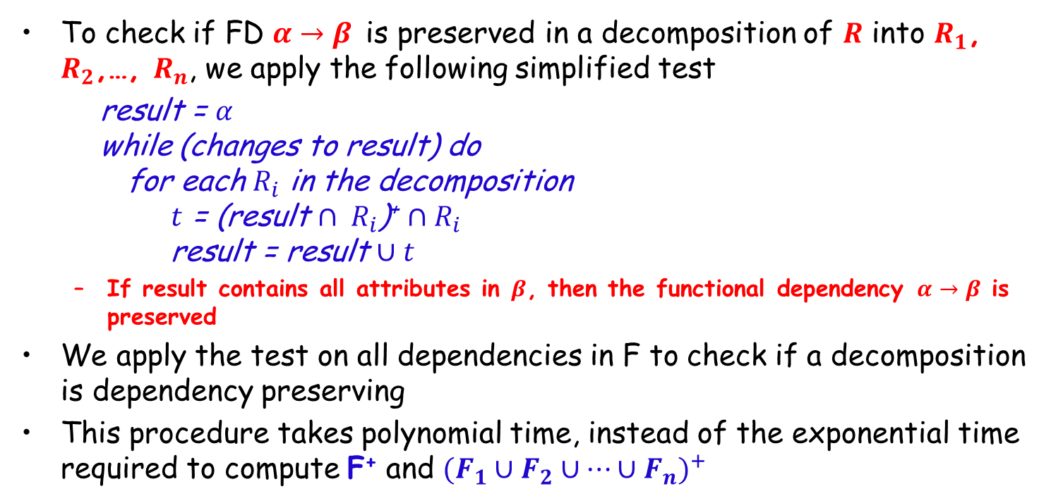
Testing for Dependency Preservation
To check if FD $α→β$ is preserved in a decomposition of $R$ into $R_{1}$, $R_{2}$,…, $R_{n}$, we apply the following simplified test
result = $α$ while (changes to result) do for each $R_{i}$ in the decomposition $t$ = (result $∩ R_{i}$)⁺ $∩R_{i}$ result = result $∪t$
If result contains all attributes in $β$, then the functional dependency $α→β$ is preserved
We apply the test on all dependencies in F to check if a decomposition is dependency preserving
This procedure takes polynomial time, instead of the exponential time required to compute F⁺ and ${(F_{1}∪F_{2}∪…∪F_{n})}^{+}$
Notes:
保持依赖测试：用依赖关系中的左侧属性a滚动各个关系合并可决定的属性，最后检查是否包含b中所有属性

Slide 65
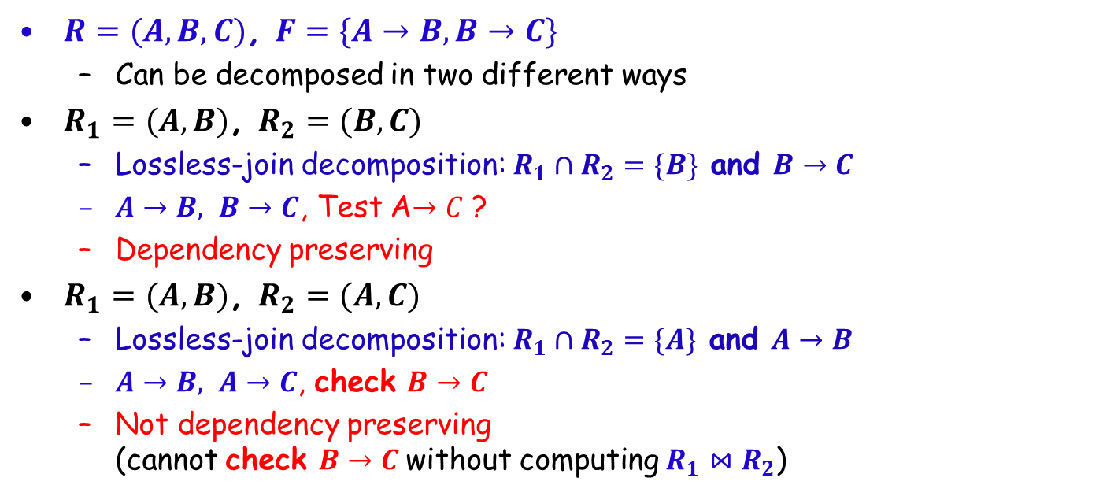
Example
$R=(A,B,C)$, $F=\{A→B,B→C\}$
Can be decomposed in two different ways
$R_{1}=(A,B)$, $R_{2}=(B,C)$
Lossless-join decomposition: $R_{1}∩R_{2}=\{B\}$ and $B→C$
$A→B, B→C$, Test A$→C$ ?
Dependency preserving
$R_{1}=(A,B)$, $R_{2}=(A,C)$
Lossless-join decomposition: $R_{1}∩R_{2}=\{A\}$ and $A→B$
$A→B, A→C$, check $B→C$
Not dependency preserving (cannot check $B→C$without computing $R_{1}⋈R_{2}$)

Slide 66
Outline
Features of Good Relational Designs
Functional Dependencies
Decomposition using Functional Dependencies
Closure of Functional Dependencies
Closure of Attribute Sets
Canonical Cover
Lossless-join Decomposition
Dependency Preservation
☞ Normalization & Normal Forms (范式)
Multivalued Dependencies*
Database Design Process

Slide 67
Data Normalization (规范化)
The process of decomposing relations with anomalies to produce smaller and well-structured relations
To validate and improve a logical design so that it satisfies certain constraints that avoid unnecessary duplication of data
The problems of having duplication of data
Waste of space
Difficulty in consistency control

Slide 68
Well-structured Relations
A relation that contains minimal data redundancy and allows users to insert, delete, and update rows without causing data inconsistencies
Goal is to avoid anomalies
Insertion Anomaly – adding new rows forces user to create duplicate data
Deletion Anomaly – deleting rows may cause a loss of data that would be needed for other future rows
Modification Anomaly – changing data in a row forces changes to other rows because of duplication
General rule of thumb: a table should not pertain to more than one entity type
Notes:
pertain to: 属于
General rule of thumb: 首要的一般规则

Slide 69
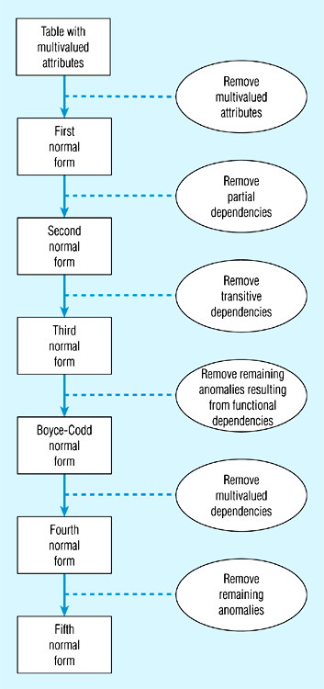
Steps in Normalization
Notes:
BC范式到第四范式是去除了一些非平凡的多值依赖，并非完全去除多值依赖

Slide 70
Atomic Domains and First Normal Form
Domain is atomic if its elements are considered to be indivisible units
attributes do not have any substructure
A relational schema R is in 1NF if the domains of all attributes of R are atomic
Non-atomic values complicate storage and encourage redundant storage of data
E.g. composite attribute/ multivalued attributes
Notes:
For composite attributes, we let each component be an attribute in its own right（在其右手边）. For multivalued attributes, we create one tuple for each item in a multivalued set. In the relational model, we formalize this idea that attributes do not have any substructure

Slide 71
First Normal Form (1NF, Cont.)
Atomicity is actually a property of how the elements of the domain are used
E.g. Strings would normally be considered indivisible
Suppose that students are given roll numbers which are strings of the form 0372001
If the first four characters are extracted to find the department, the domain of roll numbers is not atomic
Doing so is a bad idea: leads to encoding of information in application program rather than in the database

Slide 72
First Normal Form (1NF)
Requirements
No multivalued attributes
Every attribute value is atomic
E.g.,
Fig. 1 is not in 1st Normal Form (multivalued attributes)
Fig. 2 is in 1st Normal form
All relations are in 1st Normal Form

Slide 73
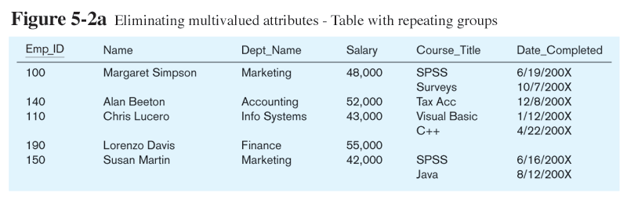
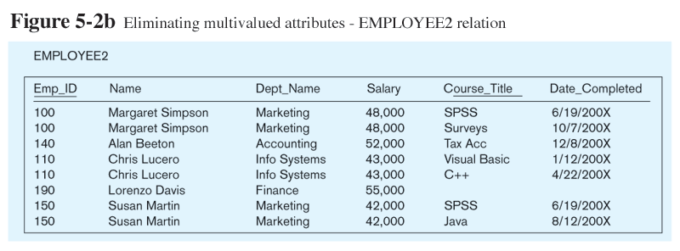
not in 1NF (multivalued attributes)
Figure 1
Figure 2
in 1NF

Slide 74
Second Normal Form
2nd Normal Form
1NF
Every non-key attribute is fully functionally dependent on the ENTIRE primary key, i.e., no partial functional dependencies
Partial functional dependency
A function dependency in which one or more non-key attributes are functionally dependent on part (but not in all) of the primary key

Slide 75
Functional Dependencies in Employee
Dependency on the entire primary key
EmpID
CourseTitle
Name
DeptName
Salary
DateCompleted
Dependency on only part of the primary key
EmpID, CourseTitle ➔ DateCompleted
EmpID ➔ Name, DeptName, Salary
As such, NOT in 2nd Normal Form!

Slide 76
Decompose a Relation to 2nd Normal Form
Decompose the relation into two separate relations
Both are full functional dependencies
Emp_t
EmpID
Name
DeptName
Salary
Emp_Course_t
EmpID
CourseTitle
DateCompleted

Slide 77
Third Normal Form
Requirements
2NF
No transitive dependencies
A transitive dependency is a functional dependency between two (or more) non-key attributes.

Slide 78
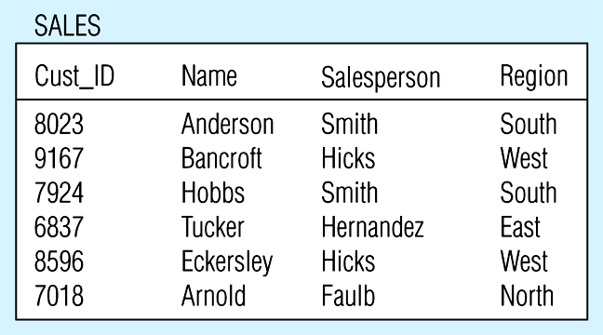
Relation with Transitive Dependency
SALES relation

Slide 79
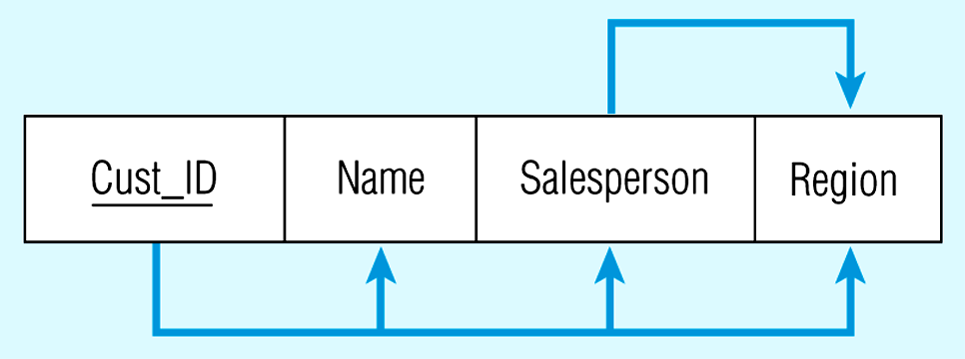
Relation with Transitive Dependency
Cust_ID → Name
Cust_ID → Salesperson
Cust_ID → Region
All this is OK
(2nd NF)
BUT
Cust_ID → Salesperson → Region
Transitive dependency
(not 3rd NF)

Slide 80
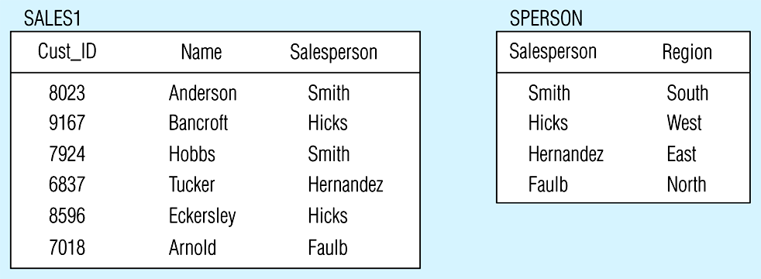
Relation with Transitive Dependency
Decompose the SALES relation

Slide 81
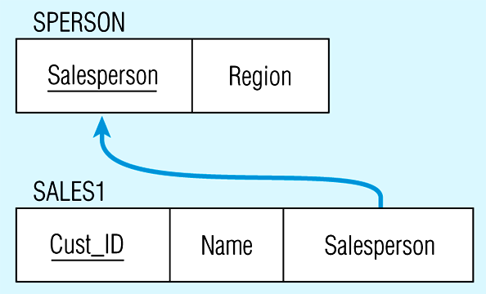
Relations in 3NF
Salesperson → Region
Cust_ID → Name
Cust_ID → Salesperson
Now, there are no transitive dependencies…
Both relations are in 3rd NF

Slide 82
Data Normalization
1st Normal Form
No multivalued attributes, and every attribute value is atomic
All relations are in 1st Normal Form
2nd Normal Form
1NF + every non-key attribute is fully functionally dependent on the ENTIRE primary key
Decomposing the relation into two new relations
3rd Normal Form
2NF + no transitive dependencies
Decomposing the relation into two new relations

Slide 83
Other Normal Forms
Boyce-Codd NF
All determinants are superkeys
4th NF
No multivalued dependencies
5th NF
No “lossless joins”

Slide 84
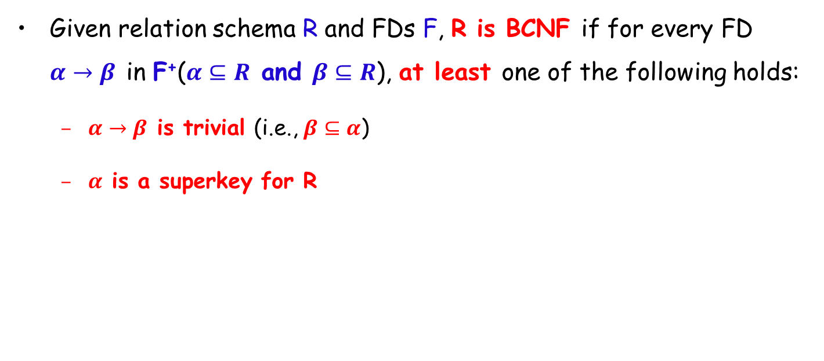
Boyce-Codd Normal Form
Given relation schema R and FDs F, R is BCNF if for every FD $α→β$ in F⁺($α⊆R$ and $β⊆R$), at least one of the following holds:
$α→β$ is trivial (i.e., $β⊆α$)
$α$ is a superkey for R
Notes:
“决定属性”(Determinant)
BCNF是指关系表中，主要功能依赖A→B的左边属性A称为“决定属性”(Determinant)，决定属性一定是候选键或主键。如果关系表拥有不符合上述规则的功能依赖，就表示有不同的数据储存在同一个关系表，需要分割关系表

Slide 85
Example
R = (A, B, C), F = {A → B, B → C }, Key = {A}
R is not in BCNF since B → C but B is not the key
Decomposition R₁ = (A, B), R₂ = (B, C)
R₁ and R₂ in BCNF
Lossless-join decomposition
Dependency preserving

Slide 86
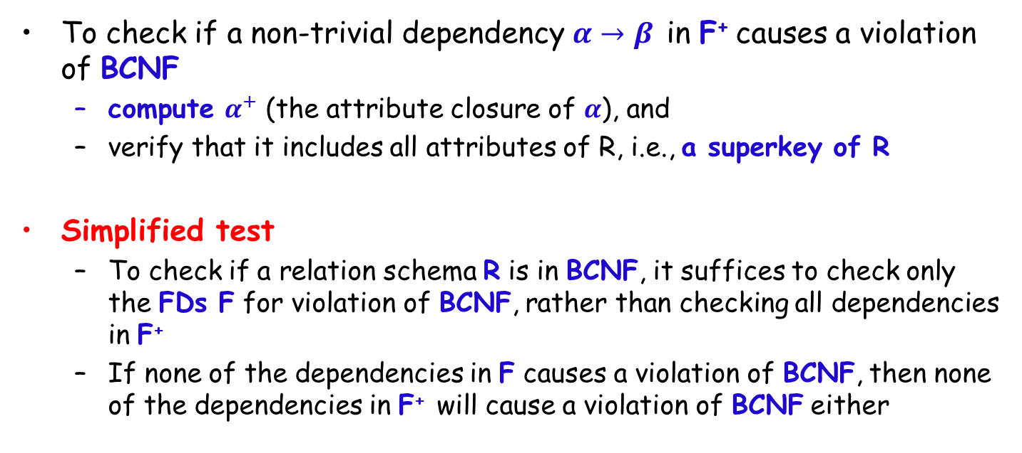
Testing for BCNF
To check if a non-trivial dependency $α→β$ in F⁺ causes a violation of BCNF
compute $α^{+}$ (the attribute closure of $α$), and
verify that it includes all attributes of R, i.e., a superkey of R
Simplified test
To check if a relation schema R is in BCNF, it suffices to check only the FDs F for violation of BCNF, rather than checking all dependencies in F⁺
If none of the dependencies in F causes a violation of BCNF, then none of the dependencies in F⁺ will cause a violation of BCNF either

Slide 87
Testing for BCNF (Cont.)
Using only F is incorrect when testing a relation in a decomposition of R
E.g., consider R (A, B, C, D) with F = {A → B, B → C}
Decompose R into R₁(A,B) and R₂(A,C,D)
Neither of the dependencies in F contain only attributes from (A,C,D) so we might be mislead into thinking that R₂ satisfies BCNF
In fact, dependency A → C in F⁺ shows that R₂ is not in BCNF
Notes:
只用F测试是否BCNF是可以的，但用来判断分解是否是BCNF就不够了

Slide 88
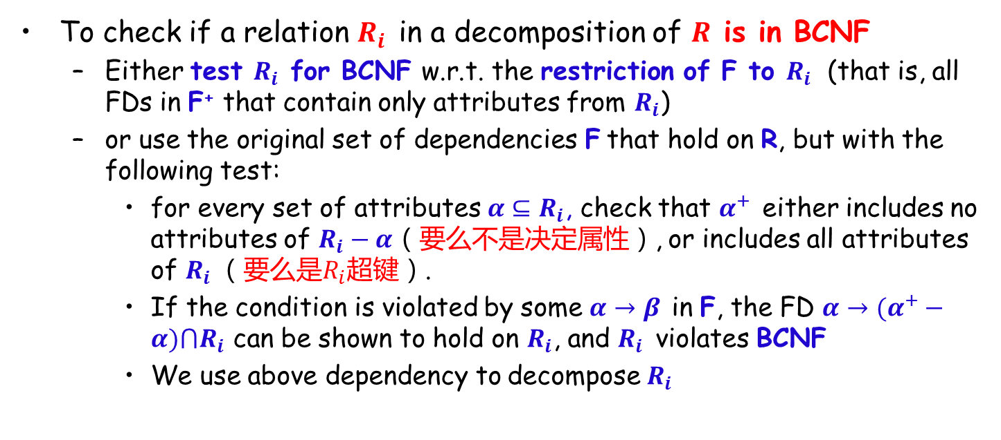
Testing Decomposition for BCNF
To check if a relation $R_{i}$ in a decomposition of $R$ is in BCNF
Either test $R_{i}$ for BCNF w.r.t. the restriction of F to $R_{i}$ (that is, all FDs in F⁺ that contain only attributes from $R_{i}$)
or use the original set of dependencies F that hold on R, but with the following test:
for every set of attributes $α⊆R_{i}$, check that $α^{+}$ either includes no attributes of $R_{i}−α$（要么不是决定属性）, or includes all attributes of $R_{i}$（要么是$R_{i}$超键）.
If the condition is violated by some $α→β$ in F, the FD $α→(α^{+}−α)⋂R_{i}$ can be shown to hold on $R_{i}$, and $R_{i}$ violates BCNF
We use above dependency to decompose $R_{i}$

Slide 89
BCNF Decomposition Algorithm
result := {R }; done := false; compute F ⁺ ; while (not done) do if (there is a schema R_{i} in result that is not in BCNF) then begin let α→β be a nontrivial FD that holds on R_{i} such that α→R_{i} is not in F ⁺, and α∩β = ∅; result := (result – R_{i}) ∪ (R_{i} – β) ∩ (α, β); end else done := true;
Note: each R_{i} is in BCNF, and decomposition is lossless-join.
Notes:
(R_{i} – β) ∩ (α, β )=α
因此，result把R_i踢掉后把α加了回来

Slide 90
Example
Consider the relation scheme CTHRSG, where C=course, T=teacher, H=hour, R=room, S=student, and G=grade. The functional dependencies F we assume are:
CS→G: each student has one grade in each course
C→T: each course has one teacher
HR→C: only one course can meet in a room at one time
HS→R: a student can be in only one room at one time
TH→R: a teacher can be in only one room at one time

Slide 91
Decomposition Tree
CTHRSG
Key=HS
CS→G C→T
HR→C HS→R
TH→R
CTHRS
Key=HS
C→T
HR→C HS→R
TH→R
CSG
Key=CS
CS→G
CHRS
Key=HS
HR→C HS→R
CH→R
CT
Key=C
C→T
HSR
Key=HS
HS→R
CHR
Key=HR或CH
HR→C或CH→R
or
CHS
Key=HS
HS→C

Slide 92
BCNF and Dependency Preservation
It is not always possible to get a BCNF decomposition that is dependency preserving
R = (J, K, L), F = {JK → L, L → K}, two candidate keys = JK and JL
R is not in BCNF
Any decomposition of R will fail to preserve
JK → L 或者 L → K
Notes:
无损分解：对
保持依赖：不对。这里的例子：LK,JL

Slide 93
Third Normal Form: Motivation
There are some situations where
BCNF is not dependency preserving, and
Efficient checking for FD violation on updates is important
Solution: define a weaker normal form, i.e., Third Normal Form
Allows some redundancy
But FDs can be checked on individual relations without computing a join
There is always a lossless-join, dependency-preserving decomposition into 3NF
Notes:
是否无损用表格法，是否函数依赖保持用代码检验

Slide 94
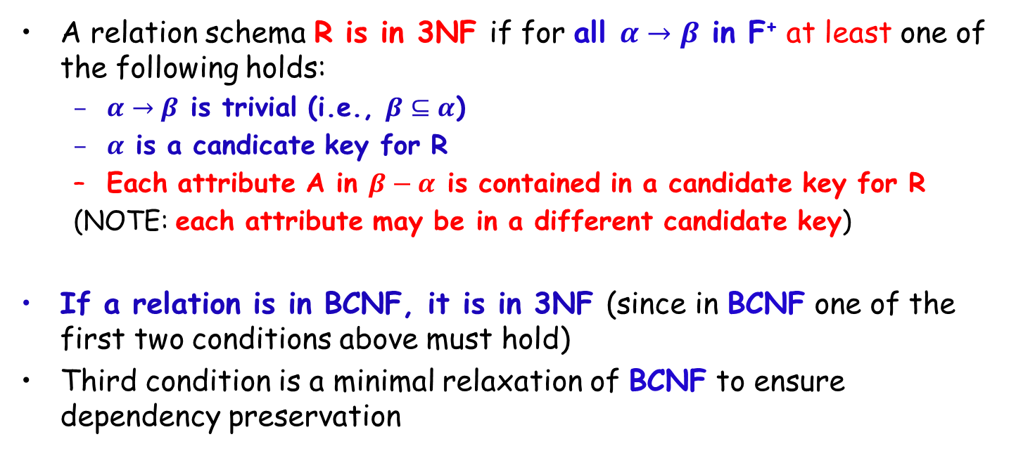
Third Normal Form
A relation schema R is in 3NF if for all $α→β$ in F⁺ at least one of the following holds:
$α→β$ is trivial (i.e., $β⊆α$)
$α$ is a candicate key for R
Each attribute A in $β−α$ is contained in a candidate key for R
(NOTE: each attribute may be in a different candidate key)
If a relation is in BCNF, it is in 3NF (since in BCNF one of the first two conditions above must hold)
Third condition is a minimal relaxation of BCNF to ensure dependency preservation
Notes:
Each attr. A in β – α is contained in a candidate key for R.意思是，如果α→β 中α不是candidate keys,那么如果β – α 是主属性则是3NF，否则不是。而BCNF即使β – α 是主属性也不行，α必须是候选键。

Slide 95
3NF (Cont.)
Example
R = (J, K, L), F = {JK → L, L → K}, two candidate keys: JK and JL
R is in 3NF
JK → L JK is a superkey/ candidate key
L → K K is contained in a candidate key
BCNF decomposition has (JL) and (LK), and testing for JK → L requires a join
There is some redundancy in this schema
Equivalent to example:
Banker-schema = (branch-name, customer-name, banker-name)
banker-name → branch name,
branch-name, customer-name → banker-name

Slide 96

Testing for 3NF
Optimization: Need to check only FDs in F
Use attribute closure to check for each dependency $α→β$, if $α$ is a superkey.
If $α$ is not a superkey, we have to verify if each attribute in $β$ is contained in a candidate key of R
this test is rather more expensive, since it involve finding candidate keys
testing for 3NF has been shown to be NP-hard
Interestingly, decomposition into 3NF can be done in polynomial time

Slide 97

3NF Decomposition Algorithm
Let F_{c} be a canonical cover for F; i := 0; for each FD α→β in F_{c} do if none of the schemas R_{j}, 1 ≤ j ≤ i contains α, β then begin i := i + 1; R_{i} := α β end
end if none of the schemas R_{j}, 1 ≤ j ≤ i contains a candidate key for R then begin i := i + 1; R_{i} := any candidate key for R; end return (R₁, R₂, ..., R_{i})
The algorithm ensures that each relation schema $R_{i}$ is in 3NF, and decomposition is dependency preserving and lossless-join

Slide 98

3NF Decomposition Example 1
R<U, F>, U={A,B,C,D,E}, F={AB→CDE, AC→BDE, B→C, C→D, B→E}
R is in which NF? Decompose R into 3NF, and the decomposition is dependency preserving and lossless-join
1) Fc={AC→B, B→C, C→D, B→E};
2) Find candidate keys: AC、AB;
key-attributes are: A、B、C;
for C→D, non-key attribute D is partial dependent on key AC, so R $∉$2NF, R$∈$1NF.
3) Decompose R into 3NF：
All attributes exist in F, and does not exist X→A $∈$F and XA=U
So decompose R into (Same LHS attributes):
U1={A,B,C}, F1={AC → B, B → C }
U2={B,C,E}, F2={B → C, B → E }
U3={C,D}, F3={C → D }
$ρ$={R1<U1,F1>, R2<U2,F2>, R3<U3,F3>}, the decomposition is dependency preserving. And candidate keys AC、AB are all in U1, so a row can be found as a1, a2, a3, a4, a5 for testing lossless-join form, so $ρ$ is lossless-join.

Slide 99

3NF Decomposition Example 2
R<U, F>, U={A,B,C,D}, F={A→C, C→A, B→AC, D→AC, BD→A}.
R is in which NF? Decompose R into 3NF, and the decomposition is dependency preserving and lossless-join
1) Fc={A → C, C → A, B → A, D → A}
2) Candidate keys of R：BD; key-attributes: B、D;
For B→A and D→A, non-key attribute A is partial dependent on key BD, so R$∉$2NF, R$∈$1NF
3) Decompose R into 3NF：
All attributes exist in F, and does not exist X→A $∈$F and XA=U
So decompose R into (Same LHS attributes):
U1={A,C}, F1={ A → C, C → A }
U2={A,B}, F2={ B → A }
U3={A,D}, F3={ D → A }
$ρ$={R1<U1,F1>, R2<U2,F2>, R3<U3,F3>}, the decomposition is dependency preserving. But candidate key BD is not in any Ui, so τ =ρ $∪$ {R*<X,Fx>} = ρ $∪$ {R4<{B,D},Φ>}, and τ is the decomposition that is dependency preserving and lossless-join

Slide 100
Example
Relation schema:
Banker-info-schema = (branch-name, customer-name, banker-name, office-number)
The FDs for this relation schema are:
banker-name → branch-name office-number customer-name branch-name → banker-name
The key is:
{customer-name, branch-name}

Slide 101
Applying 3NF to Banker-info-schema
The for loop in the algorithm causes us to include the following schemas in our decomposition:
Banker-office-schema = (banker-name, branch-name, office-number) Banker-schema = (customer-name, branch-name, banker-name)
Since Banker-schema contains a candidate key for Banker-info-schema, we are done with the decomposition process

Slide 102
Comparison of BCNF and 3NF
It is always possible to decompose a relation into relations in 3NF and
the decomposition is lossless
the dependencies are preserved
It is always possible to decompose a relation into relations in BCNF and
the decomposition is lossless
it may not be possible to preserve dependencies.

Slide 103
Comparison of BCNF and 3NF (Cont.)
Example of problems due to redundancy in 3NF
R = (J, K, L) F = {JK → L, L → K}
A schema that is in 3NF but not in BCNF has the problems of repetition of
information (e.g., the relationship l₁, k₁)
need to use null values (e.g., to represent the relationship l₂, k₂ where there is no corresponding value for J)
J
L
K
j₁
j₂
j₃
null
l₁
l₁
l₁
l₂
k₁
k₁
k₁
k₂

Slide 104
Design Goals
Goal for a relational database design:
BCNF
Lossless join
Dependency preservation
If we cannot achieve this, we accept one of
Lack of dependency preservation
Redundancy due to use of 3NF

Slide 105
Design Goals (Cont.)
Interestingly, SQL does not provide a direct way of specifying FDs other than superkeys.
Can specify FDs using assertions, but they are expensive to test
Even if we had a dependency preserving decomposition, using SQL we would not be able to efficiently test a FD whose left hand side is not a key.

Slide 106

Testing for FDs Across Relations
If decomposition is not dependency preserving, we can have an extra materialized view for each dependency $α→β$ in F_{c} that is not preserved in the decomposition
The materialized view is defined as a projection on $αβ$ of the join of the relations in the decomposition
Many newer database systems support materialized views and database system maintains the view when the relations are updated.
No extra coding effort for programmer

Slide 107

Testing for FDs Across Relations (Cont.)
The functional dependency $α→β$ is expressed by declaring $α$ as a candidate key on the materialized view
Checking for candidate key cheaper than checking $α→β$
BUT:
Space overhead: for storing the materialized view
Time overhead: Need to keep materialized view up to date when relations are updated
Database system may not support key declarations on materialized views

Slide 108
Outline
Features of Good Relational Designs
Functional Dependencies
Decomposition using Functional Dependencies
Closure of Functional Dependencies
Closure of Attribute Sets
Canonical Cover
Lossless-join Decomposition
Dependency Preservation
Normalization & Normal Forms (范式)
☞ Multivalued Dependencies*
Database Design Process

Slide 109

Multivalued Dependencies
There are database schemas in BCNF that do not seem to be sufficiently normalized
Consider a database
classes(course, teacher, book) such that (c, t, b)$∈$ classes means that t is qualified to teach c, and b is a required textbook for c
The database is supposed to list for each course the set of teachers any one of which can be the course’s instructor, and the set of books, all of which are required for the course

Slide 110
course
teacher
book
database
database
database
database
database
database
operating systems
operating systems
operating systems
operating systems
Avi
Avi
Hank
Hank
Sudarshan
Sudarshan
Avi
Avi
Jim
Jim
DB Concepts
Ullman
DB Concepts
Ullman
DB Concepts
Ullman
OS Concepts
Shaw
OS Concepts
Shaw
classes
There are no non-trivial functional dependencies and therefore the relation is in BCNF
Insertion anomalies – i.e., if Sara is a new teacher that can teach database, two tuples need to be inserted
(database, Sara, DB Concepts)
(database, Sara, Ullman)

Slide 111
Multivalued Dependencies (Cont.)
Therefore, it is better to decompose classes into:
course
teacher
database
database
database
operating systems
operating systems
Avi
Hank
Sudarshan
Avi
Jim
teaches
We shall see that these two relations are in 4NF
course
book
database
database
operating systems
operating systems
DB Concepts
Ullman
OS Concepts
Shaw
text

Slide 112

Multivalued Dependencies (MVDs)
Let R be a relation schema and let $α⊆R$ and $β⊆R$ . The multivalued dependency
$$α↠β$$
holds on R if in any legal relation r(R), for all pairs for tuples $t_{1}$ and $t_{2}$ in r such that $t_{1}\left[α\right]=t_{2}[α]$, there exist tuples $t_{3}$ and $t_{4}$ in r such that: $t_{1}\left[α\right]=t_{2}\left[α\right]=t_{3}\left[α\right]=t_{4}\left[α\right]$
$$t_{3}\left[β\right]=t_{1}\left[β\right]$$
$$t_{3}\left[R−β\right]=t_{2}[R−β]$$
$$t_{4}\left[β\right]=t_{2}[β]$$
$$t_{4}\left[R−β\right]=t_{1}[R−β]$$

Slide 113


MVD (Cont.)
Tabular representation of $α↠β$
Functional dependencies: equality-generating dependencies 相等产生依赖
Multivalued dependencies: tuple-generating dependencies 元组产生依赖

Slide 114

MVD (Cont.)
Properties of MVD
Symmetry: if X$↠$Y then X$↠$Z, here Z=U-X-Y
Transitivity: if X $↠$Y, Y $↠$Z, then X $↠$Z-Y
If X $↠$Y, X $↠$Z, then X $↠$YZ
If X $↠$Y, X $↠$Z, then X $↠$Y∩Z
If X $↠$Y, X $↠$Z, then X $↠$Y-Z, X $↠$Z-Y
…

Slide 115

Example
Let R be a relation schema with a set of attributes that are partitioned into 3 nonempty subsets.
Y, Z, W
We say that Y$↠$Z (Y multi-determines Z) iff for all possible relations r(R)
$<y,z_{1},w_{1}>∈r$ and $<y,z_{2},w_{2}>∈r$ then
$<y,z_{1},w_{2}>∈r$ and $<y,z_{2},w_{1}>∈r$
Note that since the behavior of Z and W are identical it follows that Y$↠$Z if Y$↠$W

Slide 116

Example (Cont.)
In our example:
course $↠$ teacher
course $↠$ book
The above formal definition is supposed to formalize the notion that given a particular value of Y (course) it has associated with it a set of values of Z (teacher) and a set of values of W (book), and these two sets are in some sense independent of each other
Note:
If Y$→$ Z then Y $↠$ Z
Indeed we have (in above notation) $z_{1}=z_{2}$ The claim follows
Notes:
Indeed we have (in above notation) z1 = z2，意思就是假设是多个元组，但相同

Slide 117

Use of Multivalued Dependencies
We use MVDs in two ways:
1. To test relations to determine whether they are legal under a given set of FDs and MVDs
2. To specify constraints on the set of legal relations. We shall concern ourselves with relations that satisfy a given set of FDs and MVDs.
If a relation $r$ fails to satisfy a given MVD, we can construct a relations $r^{′}$ that does satisfy the MVD by adding tuples to $r$
Notes:
adding tuples to r：意思是不满足一定是缺少一些交换的元组，填上就满足多值依赖了

Slide 118

Theory of MVDs
From the definition of multivalued dependency, we can derive the following rule:
If $α→β$, then $α↠β$; That is, every FD is also a MVD
The closure D⁺ of D is the set of all FDs and MVDs logically implied by D.
We can compute D⁺ from D, using the formal definitions of FDs and MVDs.
We can manage with such reasoning for very simple MVDs, which seem to be common in practice
For complex MVDs, it is better to reason about sets of dependencies using a system of inference rules

Slide 119

Fourth Normal Form
A relation schema R is in 4NF w.r.t. a set D of FDs and MVDs if for all MVDs in D⁺ of the form $α↠β$, where $α⊆R$ and $β⊆R$, at least one of the following hold:
$α↠β$ is trivial (i.e., $β⊆α$ or $α∪β=R$)
$α$ is a superkey for schema R
If a relation is in 4NF it is in BCNF
Notes:
4NF就是要求没有非平凡的多值依赖

Slide 120

Restriction of Multivalued Dependencies
The restriction of D to $R_{i}$ is the set $D_{i}$ consisting of
All FDs in D⁺ that include only attributes of Ri
All MVDs of the form
$α↠β$($β∩R_{i}$)
where $α⊆R_{i}$ and $α↠β$ is in D⁺
Notes:
要检查每个分解是否是4NF，必须要求分解后，D+在各个子表中的投影也满足4NF的判定条件

Slide 121

4NF Decomposition Algorithm
result: = {R}; done := false; compute D+; Let $D_{i}$ denote the restriction of D⁺ to $R_{i}$
while (not done) if (there is a schema $R_{i}$ in result that is not in 4NF) then begin
let $α↠β$ be a nontrivial MVD that holds on $R_{i}$such that $α→R_{i}$
is not in $D_{i}$, and $α∩β=∅$; result := (result - $R_{i}$) $∪$ (($R_{i}$ -$β$) $∩$ ($α$, $β$)); end else done:= true;
Note: each $R_{i}$is in 4NF, and decomposition is lossless-join
Notes:
无损连接，但不一定保持依赖

Slide 122
Example
R =(A, B, C, G, H, I)
F ={ A →→ B
B →→ HI
CG →→ H }
R is not in 4NF since A →→ B and A is not a superkey for R
Decomposition
a) R₁ = (A, B) (R₁ is in 4NF)
b) R₂ = (A, C, G, H, I) (R₂ is not in 4NF)
c) R₃ = (C, G, H) (R₃ is in 4NF)
d) R₄ = (A, C, G, I) (R₄ is not in 4NF)
Since A →→ B and B →→ HI, A →→ HI, A →→ I
e) R₅ = (A, I) (R₅ is in 4NF)
f)R₆ = (A, C, G) (R₆ is in 4NF)

Slide 123
Further Normal Forms
Join dependencies generalize MVDs
lead to project-join normal form (PJNF) (also called fifth normal form) 投影-连接范式
A class of even more general constraints, leads to a normal form called domain-key normal form (DKNF) 域-码范式
Problem with these generalized constraints: are hard to reason with, and no set of sound and complete set of inference rules exists
Hence rarely used

Slide 124
Outline
Features of Good Relational Designs
Functional Dependencies
Decomposition using Functional Dependencies
Closure of Functional Dependencies
Closure of Attribute Sets
Canonical Cover
Lossless-join Decomposition
Dependency Preservation
Normalization & Normal Forms (范式)
Multivalued Dependencies*
☞ Database Design Process

Slide 125
Overall Database Design Process
We have assumed schema R is given
R could have been generated when converting E-R diagram to a set of tables
R could have been a single relation containing all attributes that are of interest (called universal relation, 泛关系)
Normalization breaks R into smaller relations and normal form

Slide 126

ER Model and Normalization
When an E-R diagram is carefully designed, identifying all entities correctly, the tables generated from the E-R diagram should not need further normalization
However, in a real (imperfect) design there can be FDs from non-key attributes of an entity to other attributes of the entity
E.g. employee entity with attributes department-number and department-address, and an FD department-number $→$ department-address
Good design would have made department an entity
FDs from non-key attributes of a relationship set are possible, but rare

Slide 127

Universal Relation Approach 泛关系
Dangling tuples – Tuples that “disappear” in computing a join
Let $r_{1}(R_{1})$, $r_{2}(R_{2})$, …, $r_{n}(R_{n})$ be a set of relations
A tuple $t$ of the relation $r_{i}$ is a dangling tuple if $t$ is not in the relation:
$$Π_{R_{i}}⋈(r_{1}⋈r_{2}⋈…⋈r_{n})$$
The relation $r_{1}⋈r_{2}⋈…⋈r_{n}$is called a universal relation since it involves all the attributes in the “universe” defined by $R_{1}∪R_{2}∪…∪R_{n}$
If dangling tuples are allowed in the database, instead of decomposing a universal relation, we may prefer to synthesize a collection of normal form schemas from a given set of attributes.

Slide 128
Universal Relation Approach
Dangling tuples may occur in practical database applications
They represent incomplete information
E.g., may want to break up information about loans into:
(branch-name, loan-number)
(loan-number, amount)
(loan-number, customer-name)
Universal relation would require null values, and have dangling tuples

Slide 129
Universal Relation Approach (Cont.)
A particular decomposition defines a restricted form of incomplete information that is acceptable in our database.
Above decomposition requires at least one of customer-name, branch-name or amount in order to enter a loan number without using null values
Rules out storing of customer-name, amount without an appropriate loan-number (since it is a key, it can't be null either!)
Universal relation requires unique attribute names unique role assumption
Reuse of attribute names is natural in SQL since relation names can be prefixed to disambiguate names
Notes:
Rules out :(用直线)划去

Slide 130

Denormalization for Performance
May want to use non-normalized schema for performance
E.g., displaying customer-name along with account-number and balance requires join of account with depositor
Alternative 1: Use denormalized relation containing attributes of account as well as depositor with all above attributes
Faster lookup
Extra space and extra execution time for updates
Extra coding work for programmer and possibility of error in extra code
Alternative 2: use a materialized view defined as account $⋈$ depositor
Benefits and drawbacks same as above, except no extra coding work for programmer and avoids possible errors

Slide 131
Other Design Issues
Some aspects of database design are not caught by normalization
Examples of bad database design to be avoided: Instead of earnings(company-id, year, amount), use
earnings-2000, earnings-2001, earnings-2002, etc., all on the schema (company-id, earnings).
Above are in BCNF, but make querying across years difficult and needs a new table each year
company-year(company-id, earnings-2000, earnings-2001, earnings-2002)
Also in BCNF, but makes querying across years difficult and requires new attribute each year.
Is an example of a crosstab, where values for one attribute become column names
Used in spreadsheets, and in data analysis tools
Notes:
Crosstab:交叉表
Spreadsheets:电子数据表

Slide 132

Quiz
Given the relational schema R<U, F>, U={A,B,C,D,E }, F={AC$→$BD, B $→$C, C $→$D, B $→$E}
Use Armstrong axioms and related rules to prove the functional dependency AC $→$E
Compute (A)⁺ and (AC)⁺
Find a canonical cover F_{c} of F
Find all candidate keys, and point out R is in which normal form
Decompose R into 3NF, which the decomposition is lossless-join and dependency preserving.
Give related explanation or proof that the above decomposition is lossless-join and dependency preserving
*Decompose the relation into relations in BCNF

Slide 133
Homework
Further Reading
Chapter 7
Exercises
7.1, 7.6, 7.27
7.30 (a, b, c, d)
Submission
Canvas上提交，上传单个PDF文件
Deadline: Nov. 20 , 2023

Slide 134
End of Lecture 7

